Slide 1
Prices set to rise
Impact of current immigration policies on food prices
Phillip Connor, Ph.D.
Research Fellow, Center for Migration and Development, Princeton University
phillip@phillip-connor.com
pconnor@princeton.edu

Slide 2
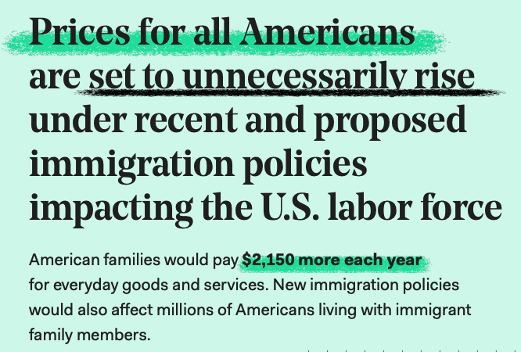
fwd.us/prices

Slide 3
Immigration policy scenarios
1. The cancellation of work permits for millions of individuals with a temporary status, like people with Temporary Protected Status (TPS) who are unable to return to their countries, paroled immigrants from Afghanistan, and Deferred Action for Childhood Arrivals (DACA), among others.
2. The mass deportation of millions of immigrants with or without legal status.
3. Significant reductions in new, lawful immigration in the years ahead.

Slide 4
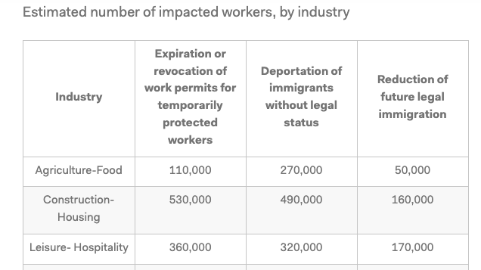

Slide 5
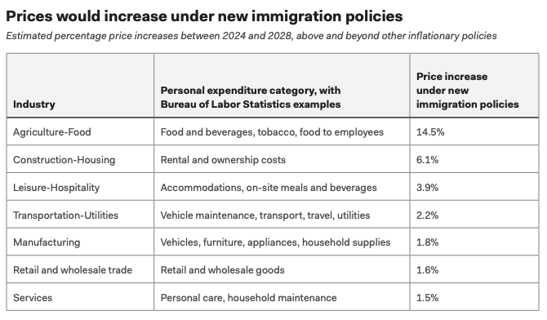

Slide 6
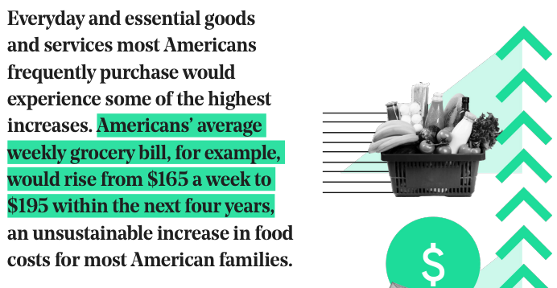

Slide 7
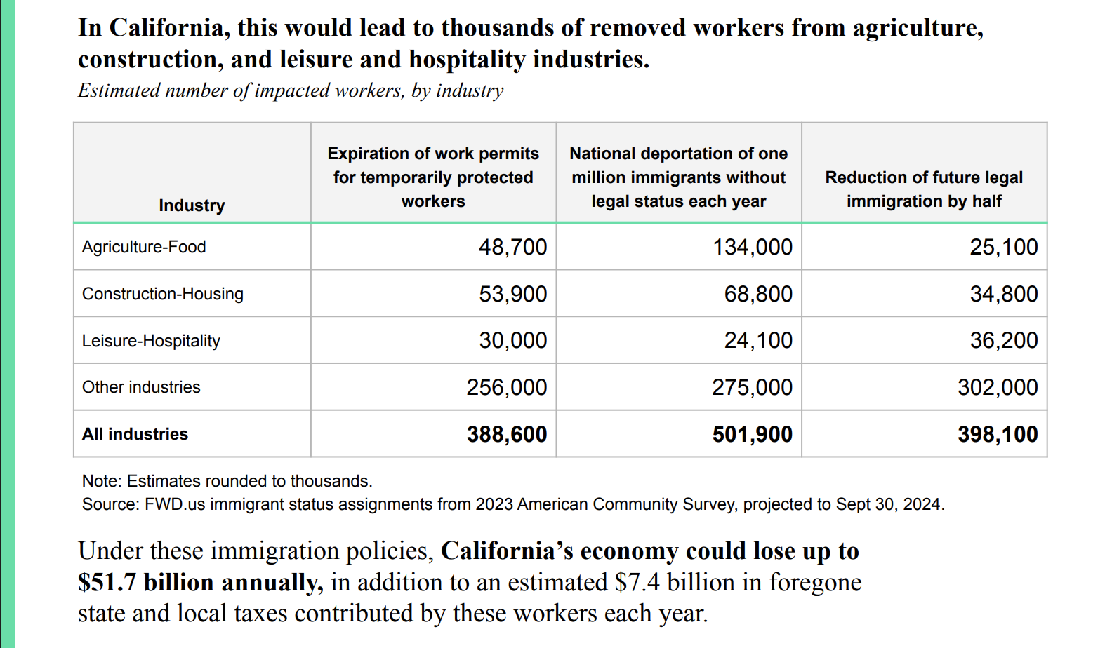

Slide 8
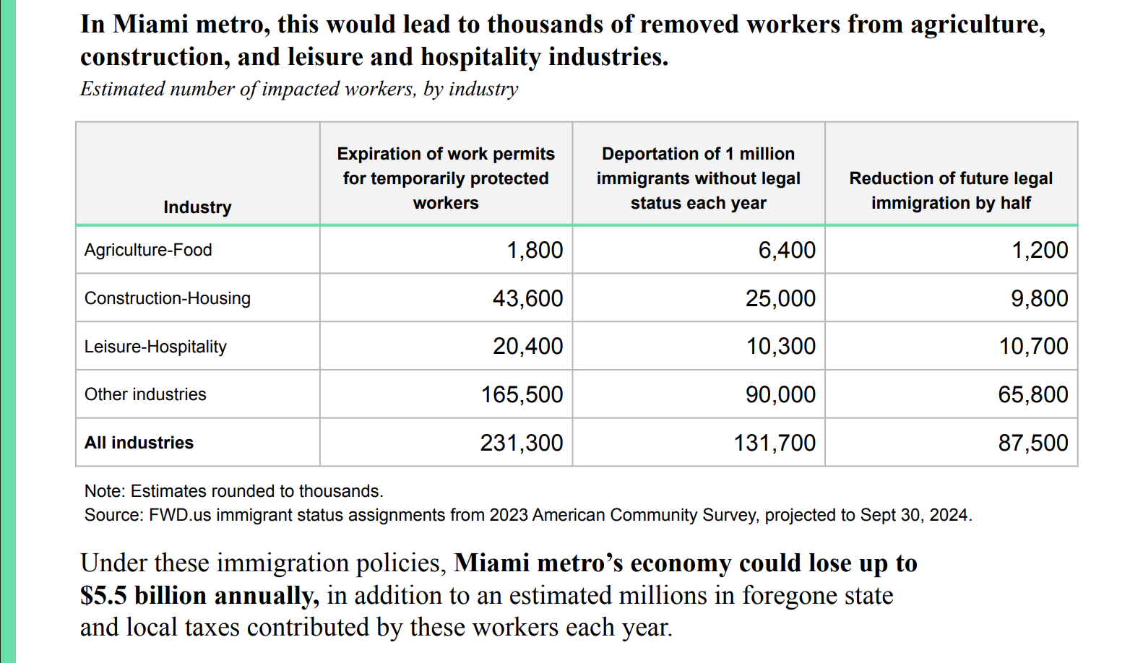

Slide 9
Prices set to rise under immigration policies
Impact of immigration policies on food prices
Phillip Connor, Ph.D.
Research Fellow, Center for Migration and Development, Princeton University
phillip@phillip-connor.com
pconnor@princeton.edu

