Slide 1
Overcoming Conflicts of Interest in the Food Sector
Sasha Chavkin
Senior Reporter, The Examination

Slide 3
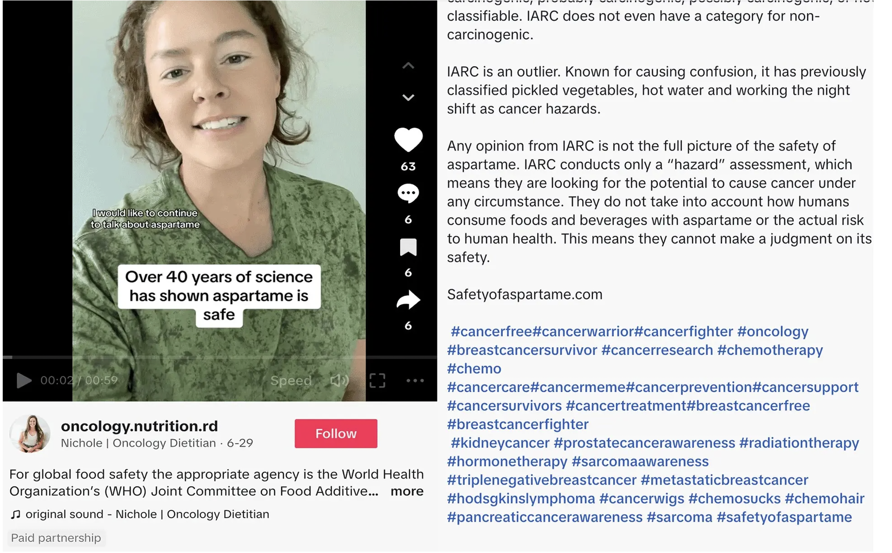

Slide 4
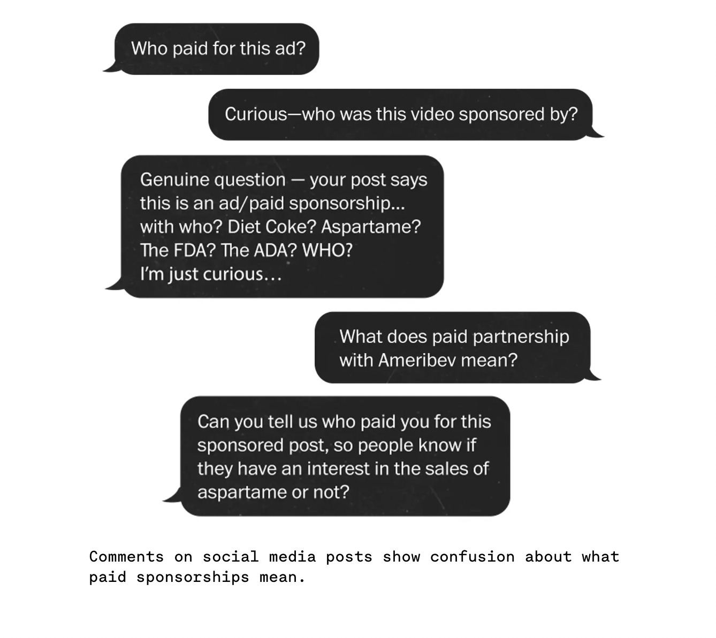

Slide 5
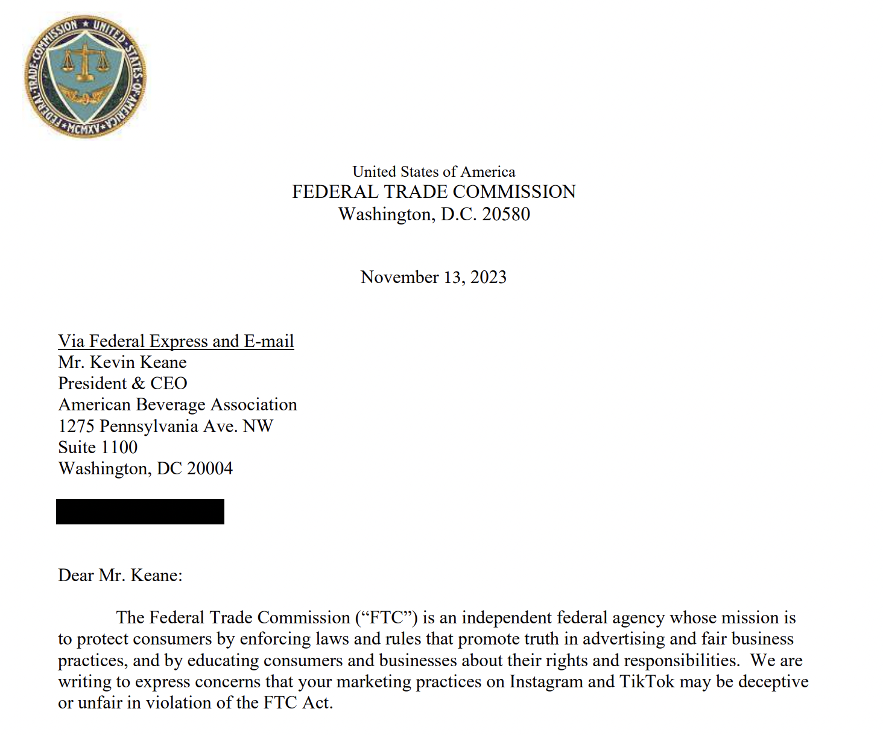

Slide 6
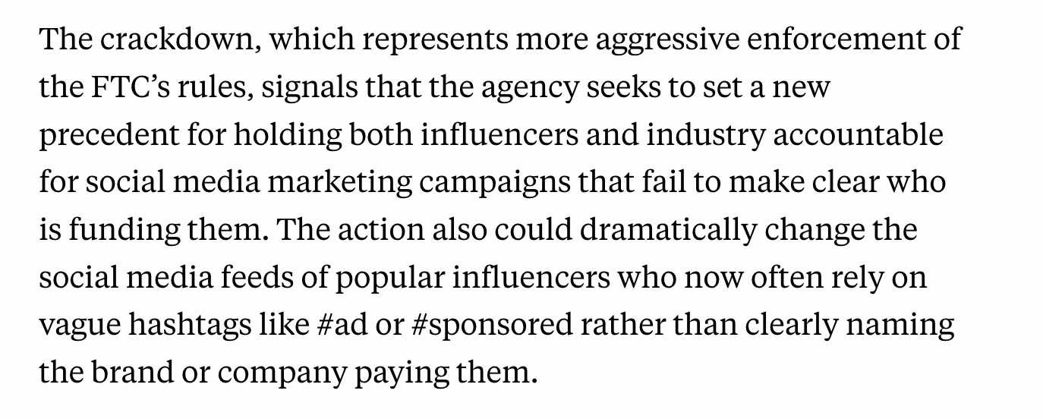

Slide 7
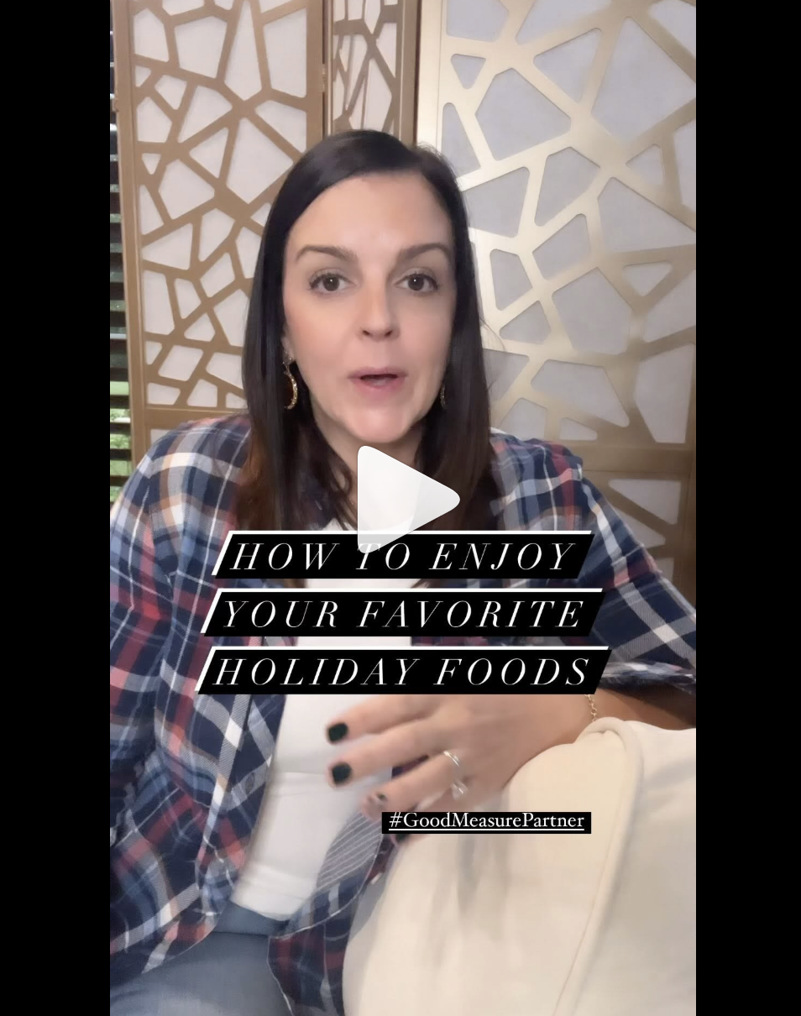

Slide 8
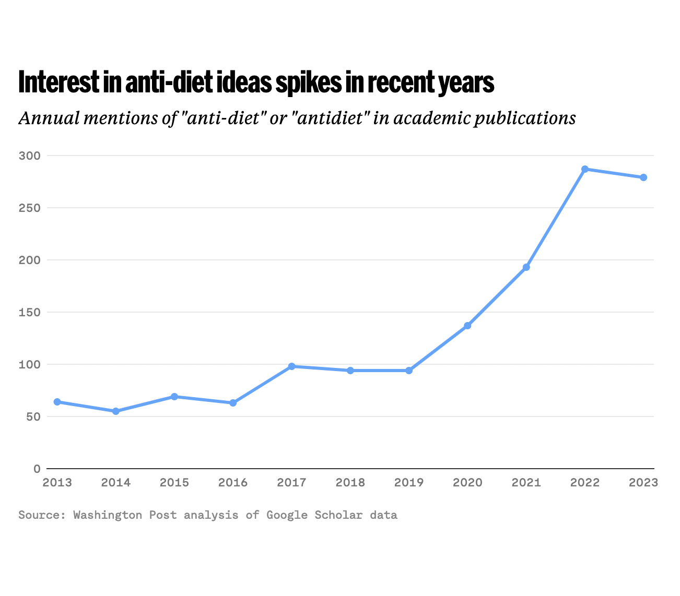
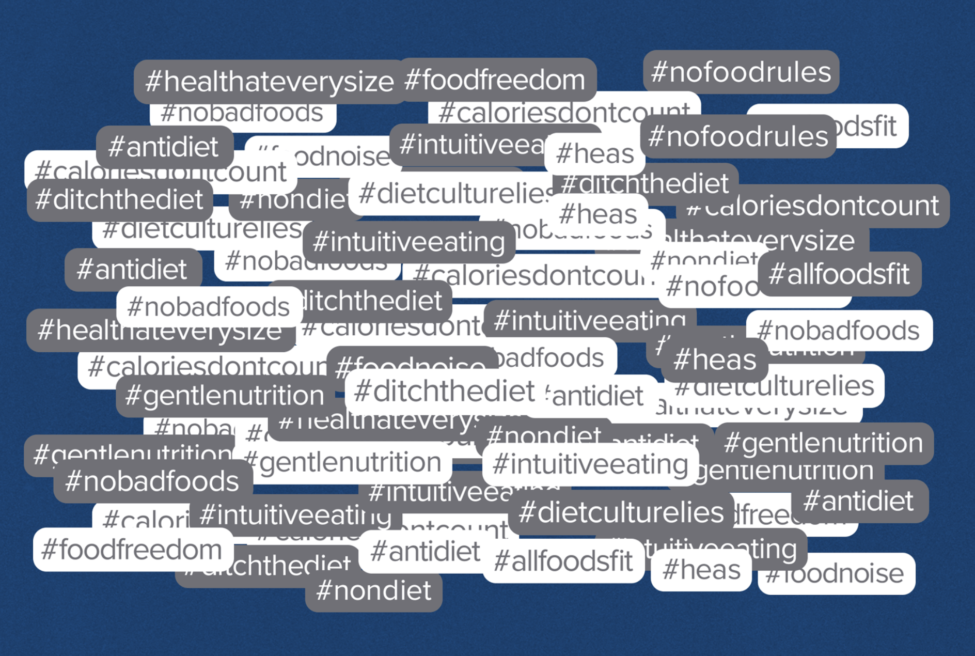

Slide 12
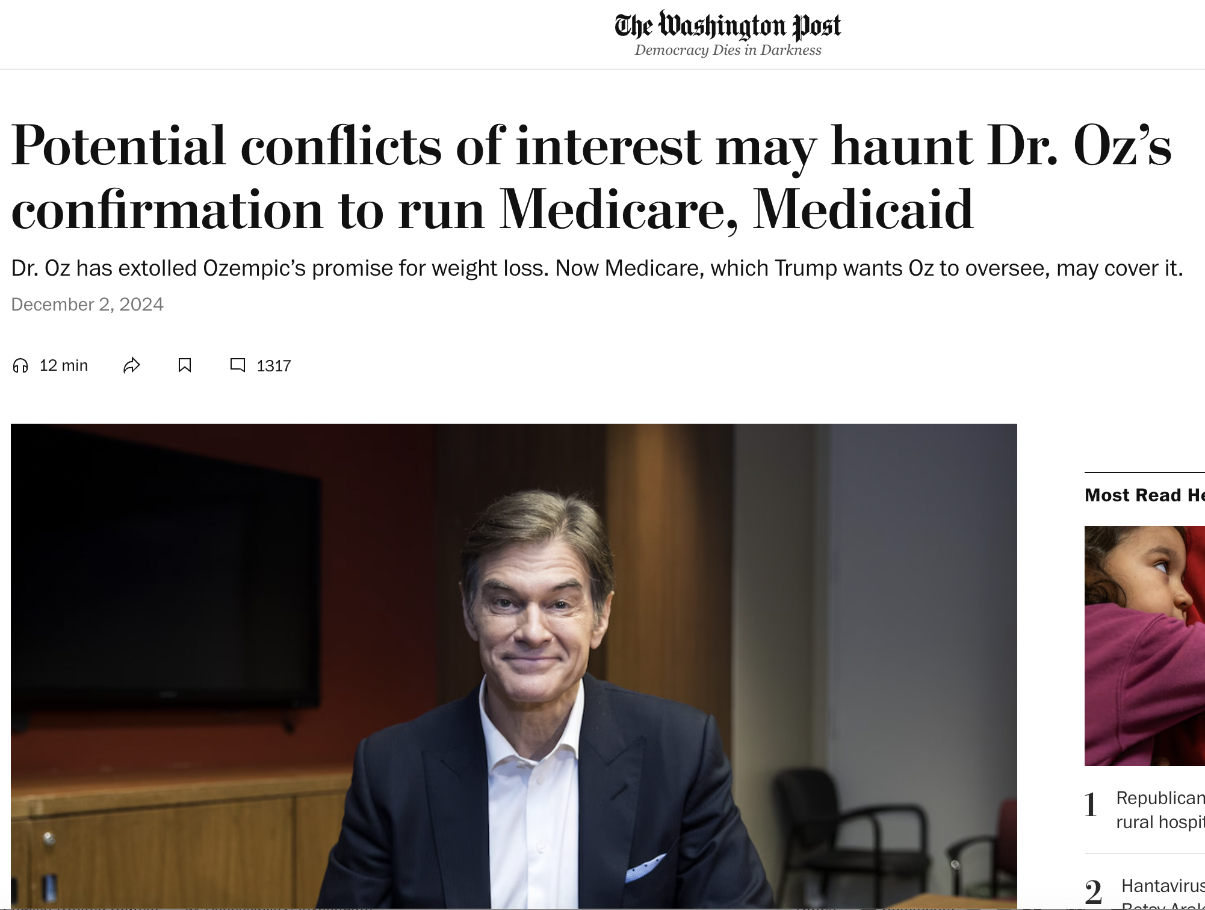

Slide 13
Sasha Chavkin, Senior Reporter
Email: sasha@theexamination.org Bluesky: @sashachavkin.bsky.social
Subscribe: https://www.theexamination.org/newsletter

