Slide 1
Unraveling the Mechanisms of
Ultra-processed Foods
Kevin D. Hall, Ph.D.
National Institute of Diabetes & Digestive & Kidney Diseases
National Institutes of Health

Slide 2

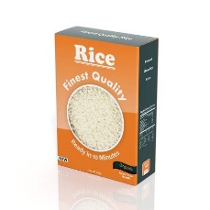
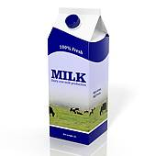
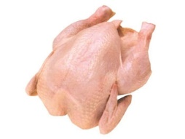
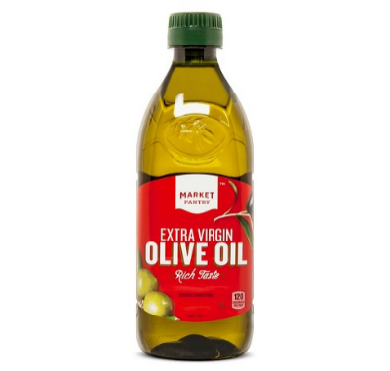
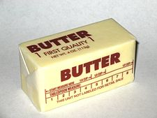
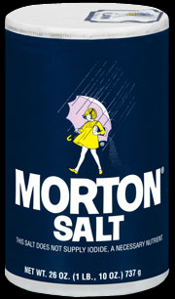
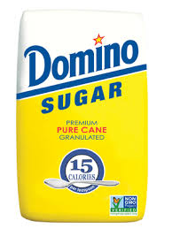


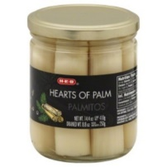
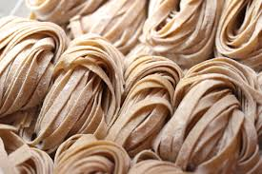
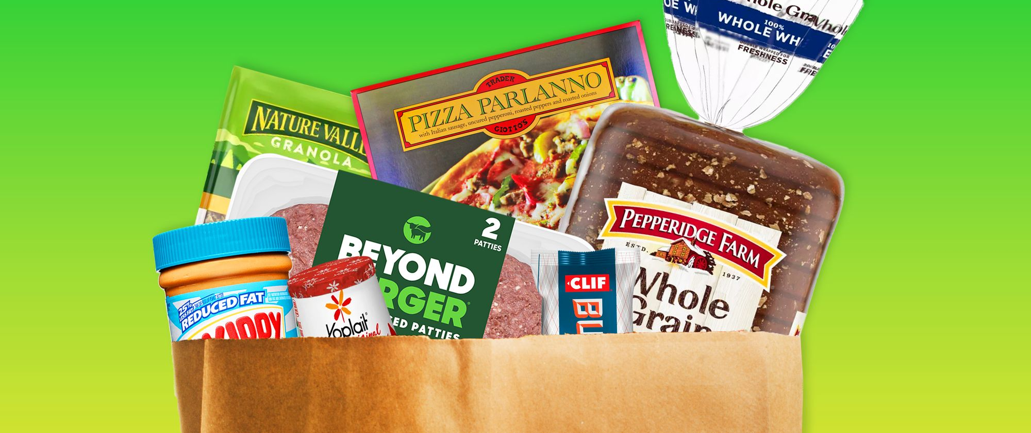
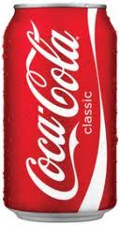

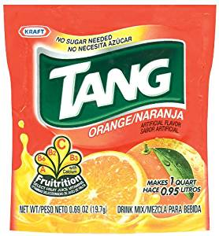
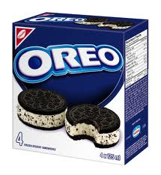

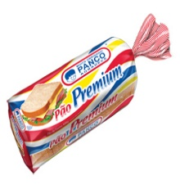

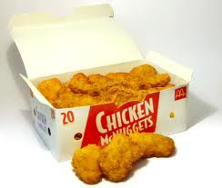

NOVA groups | Examples
1) Unprocessed or minimally processed foods Edible parts of plants and animals after separation from nature or preserved by minimal processes (no substances added)
2) Processed culinary ingredients Substances extracted from foods or nature and used to prepare, cook and season Group 1 foods
3) Processed foods Group 1 foods modified with the addition of Group 2 ingredients aiming food preservation and/or enhancement of its sensory qualities
4) Ultra-processed foods Formulations of several ingredients that include original or chemically modified food substances obtained with the fractioning of whole foods and additives used to make the final product palatable or hyper-palatable. The aim is to make convenient, tasteful and low-cost products liable to replace all other NOVA food groups
Notes:
Unlike traditional approaches in nutrition science to study foods mainly in terms of their nutrient composition, a new way to classify foods was recently introduced that ignores their nutrient composition and instead focuses on the extent and purpose of processing.

Slide 3
Whole Foods
Deconstructed
& Modified
Ingredients
(Uncommon in home-cooking)
Additives &
Preservatives
Industrial Processing
Product
+
Purpose
Convenient
Inexpensive
Palatable
Profitable
Displace NOVA 1-3
NOVA does not consider nutritional profile!
NOVA 4
Ultra-processed Food
G Scrinis & C Monteiro Nat. Food 3, 671–673 (2022)

Slide 4
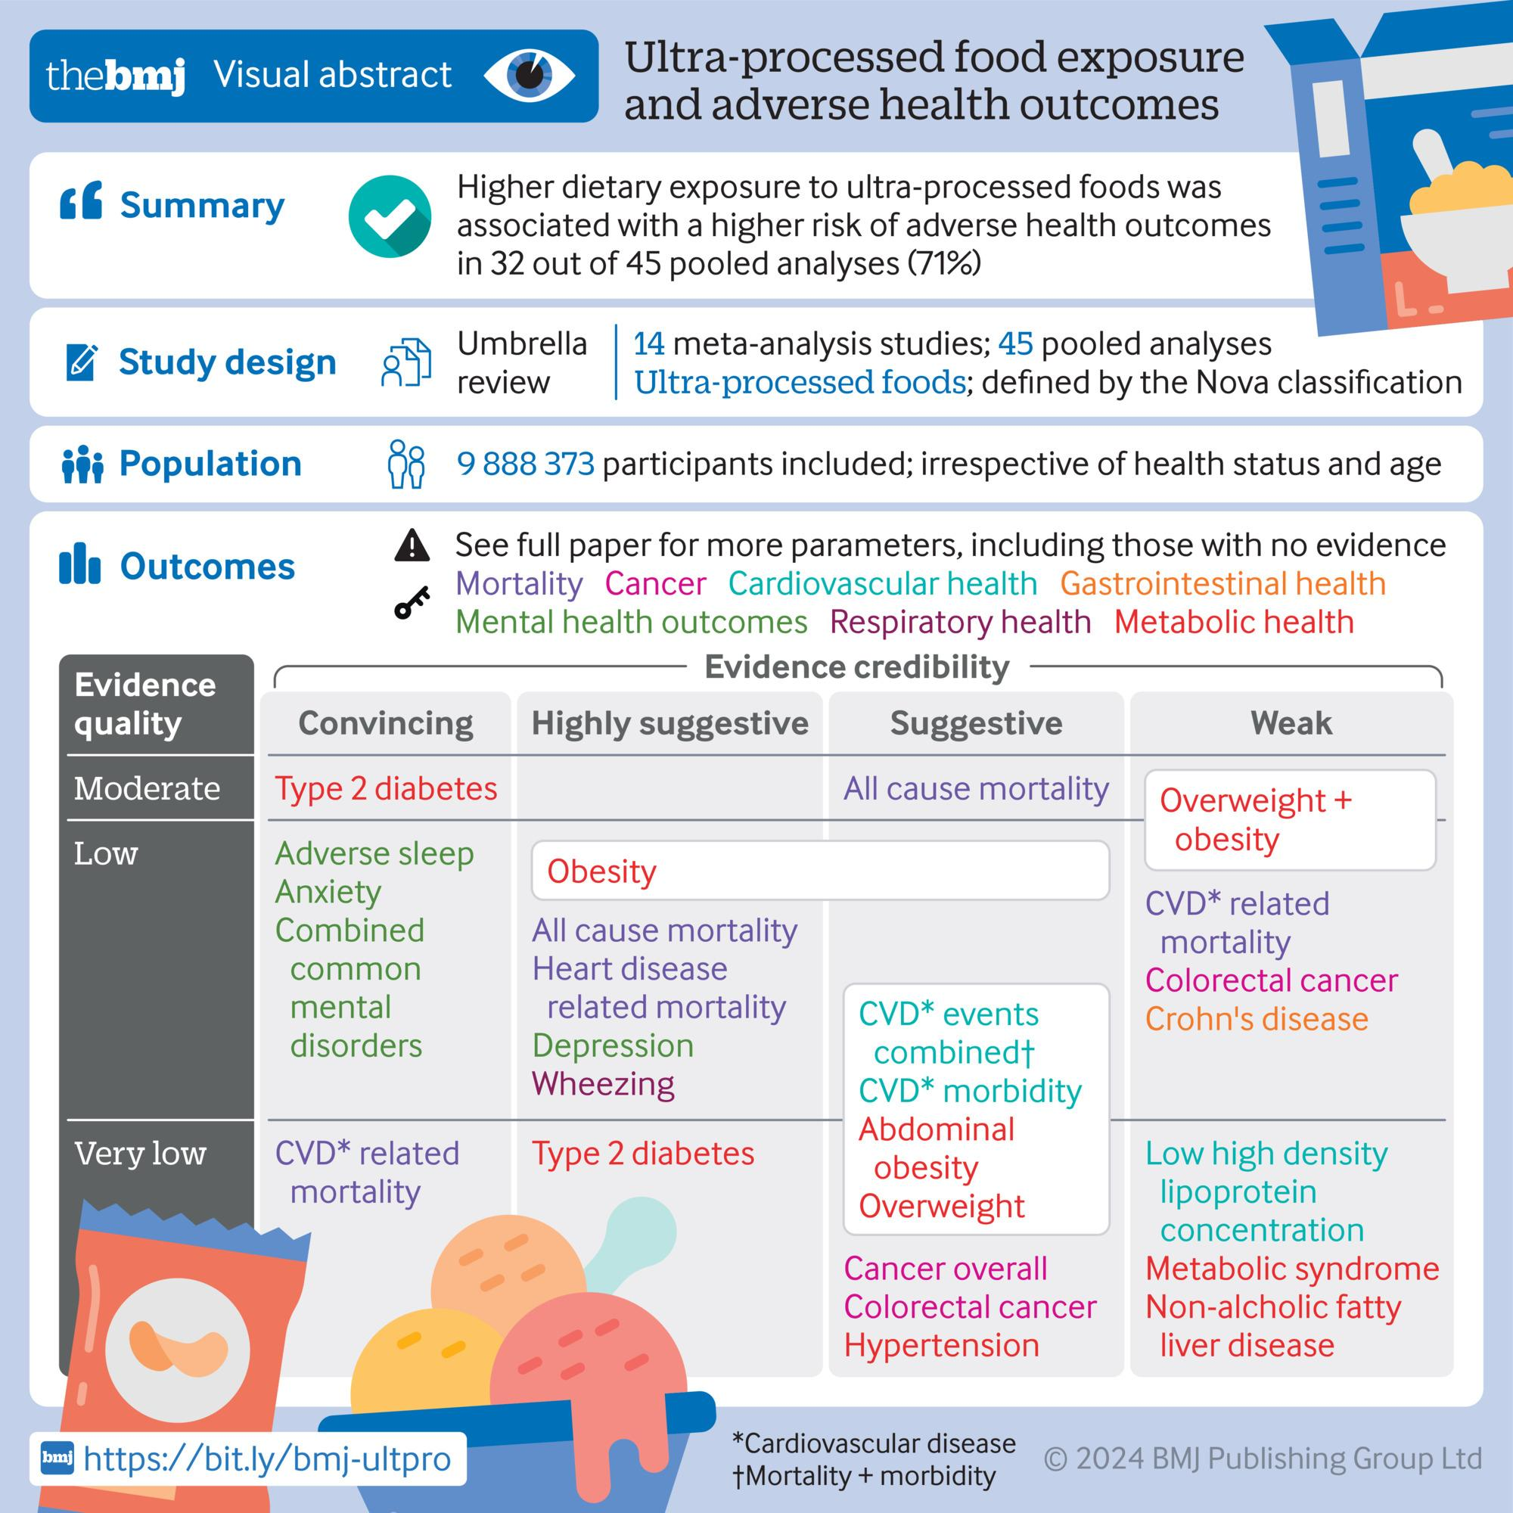
Public Health Researchers
Say UPFs are Bad News!
(even after adjusting for nutritional profile)
“The observational data shows that there’s a pretty clear association between ultra-processed food and a lot of bad health outcomes. Before FDA can do anything with that, we’re going to need a lot more research.”
FDA Commissioner Robert Califf, Jan 31, 2024

Slide 5
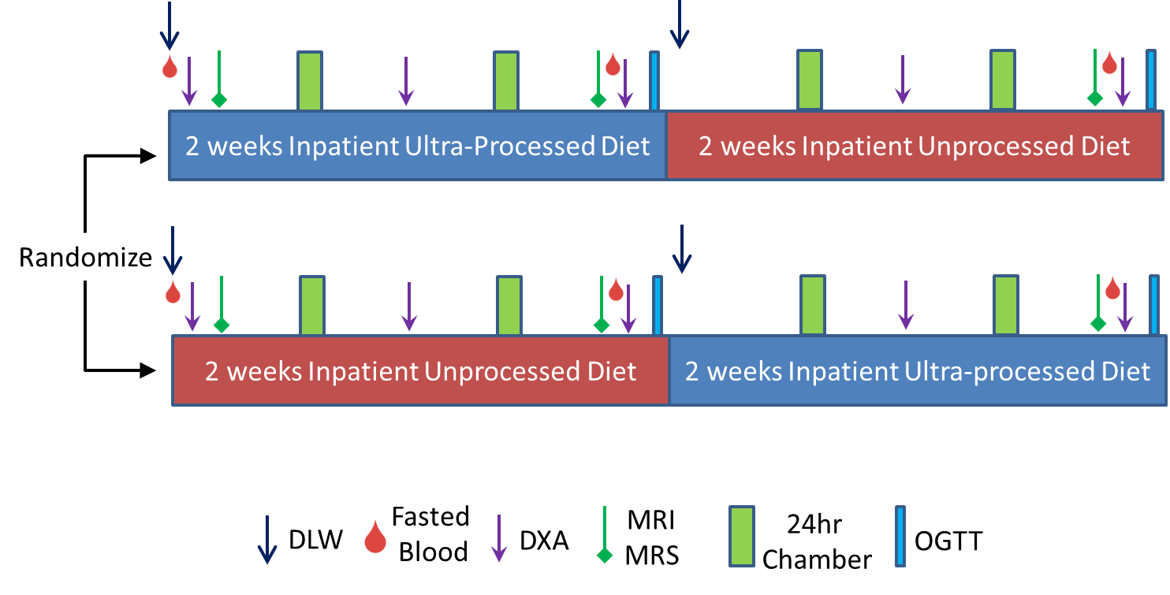
Ultra-processed vs Unprocessed Ad Libitum Diet Study
Diets matched for Presented Calories, Fat, Carbs, Sugar, Sodium, Fiber, Glycemic Load
KD Hall et al. Cell Metabolism 30:1-11 (2019).

Slide 6
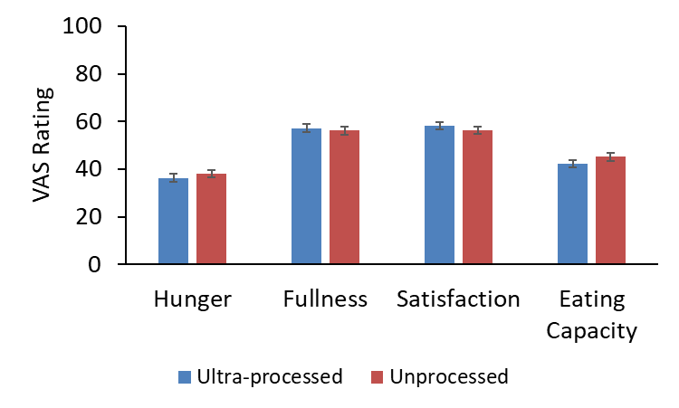
No Differences in Self-Reported Appetite Measures
490±34
492±31
1102±75
872±60
1387±105
1106±82
Mean ± SE
KD Hall et al. Cell Metabolism 30:1-11 (2019).

Slide 7
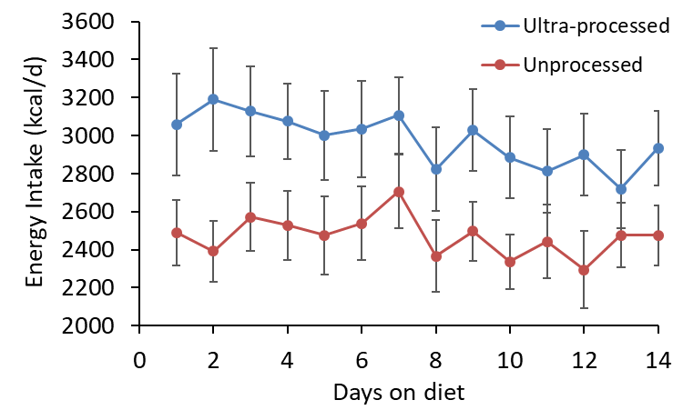
Ultra-processed Diet Caused Increased Intake
∆EI = 508 ± 106 kcal/d; P=0.0001
Mean ± SE
KD Hall et al. Cell Metabolism 30:1-11 (2019).

Slide 8
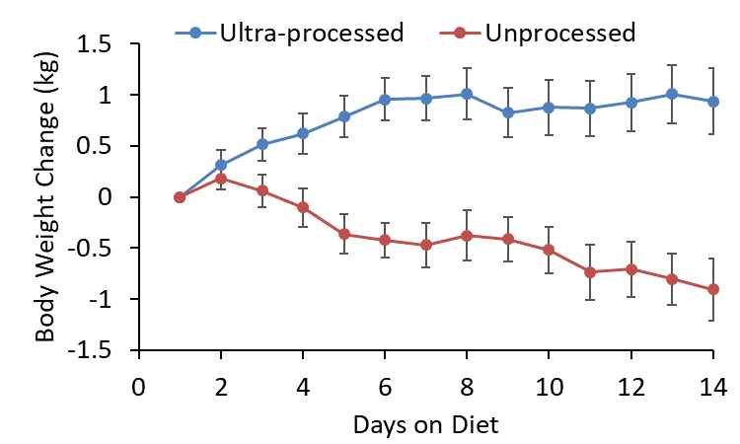
Ultra-processed Diet Caused Weight Gain
Mean ± SE
KD Hall et al. Cell Metabolism 30:1-11 (2019).

Slide 9
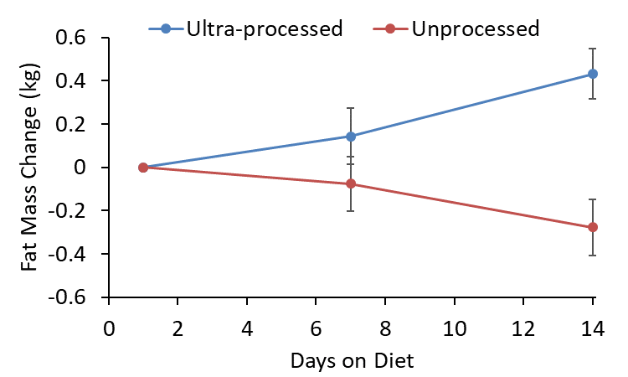
Ultra-processed Diet Caused Body Fat Gain
Mean ± SE
KD Hall et al. Cell Metabolism 30:1-11 (2019).

Slide 10

Mechanisms of Excess Intake with Ultra-processed Diets?

Slide 11
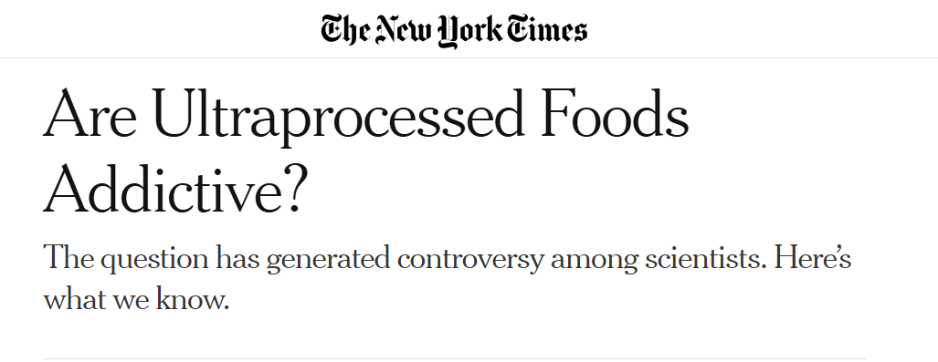

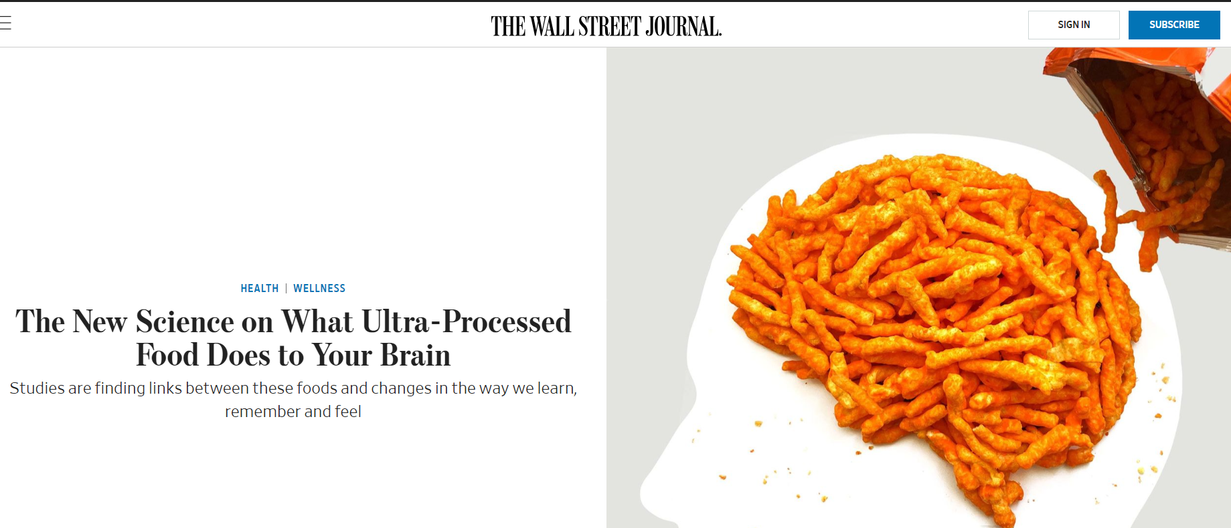
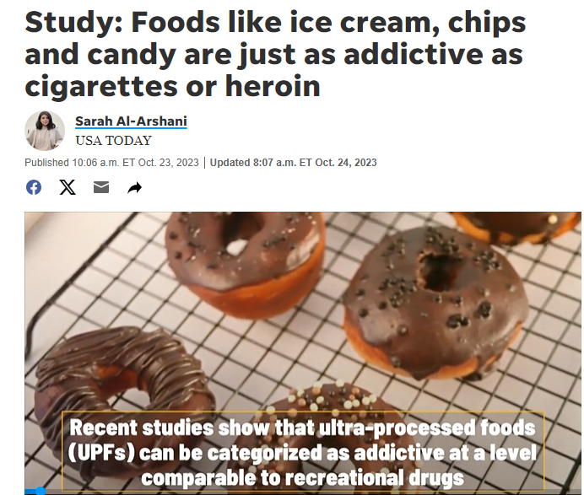
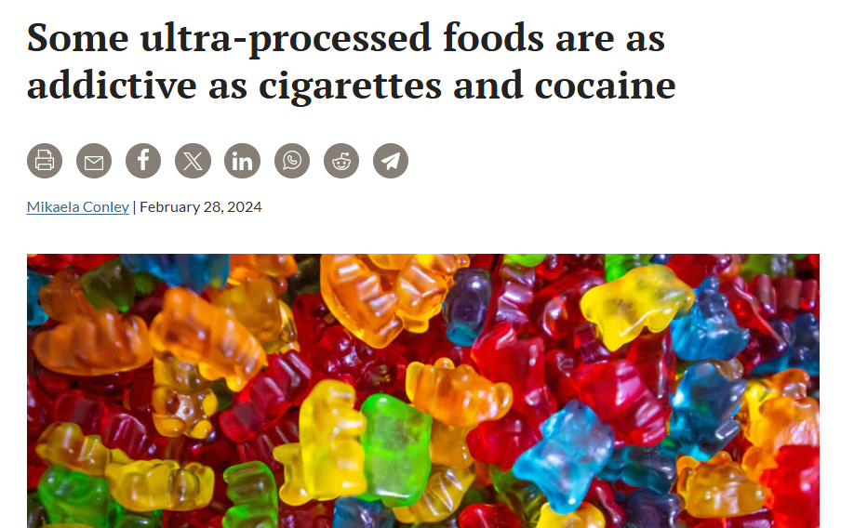
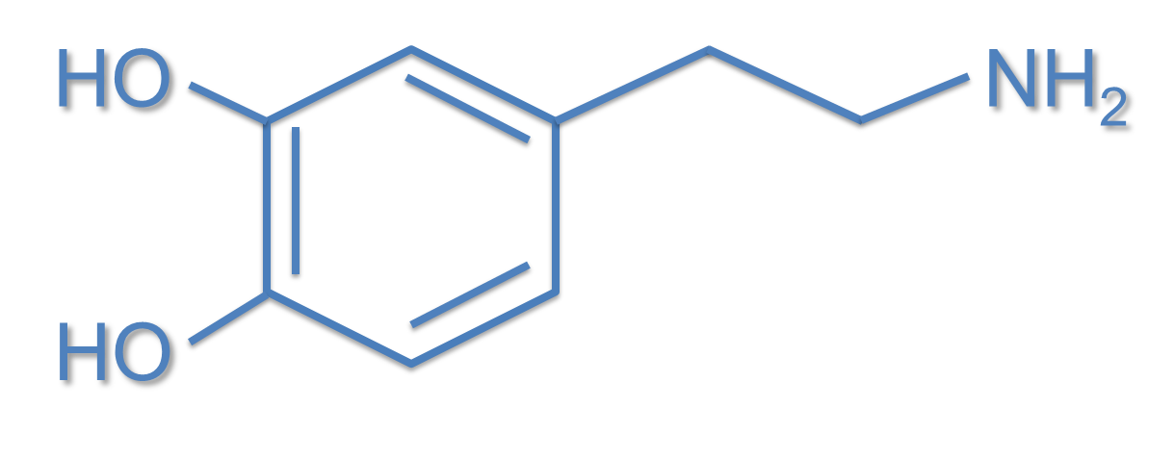
Dopamine

Slide 12
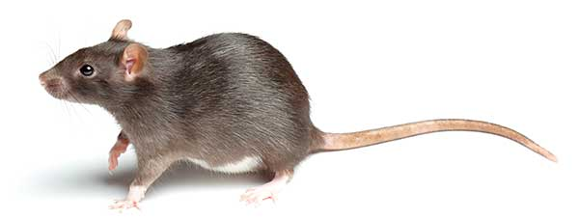
Refined carbohydrates or fats evoke similar levels of extracellular dopamine in the brain striatum to those seen with addictive substances
Gearhardt et al. BMJ 383:e075354 (2023)

Slide 13
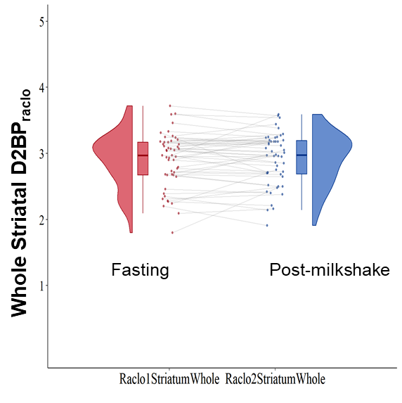
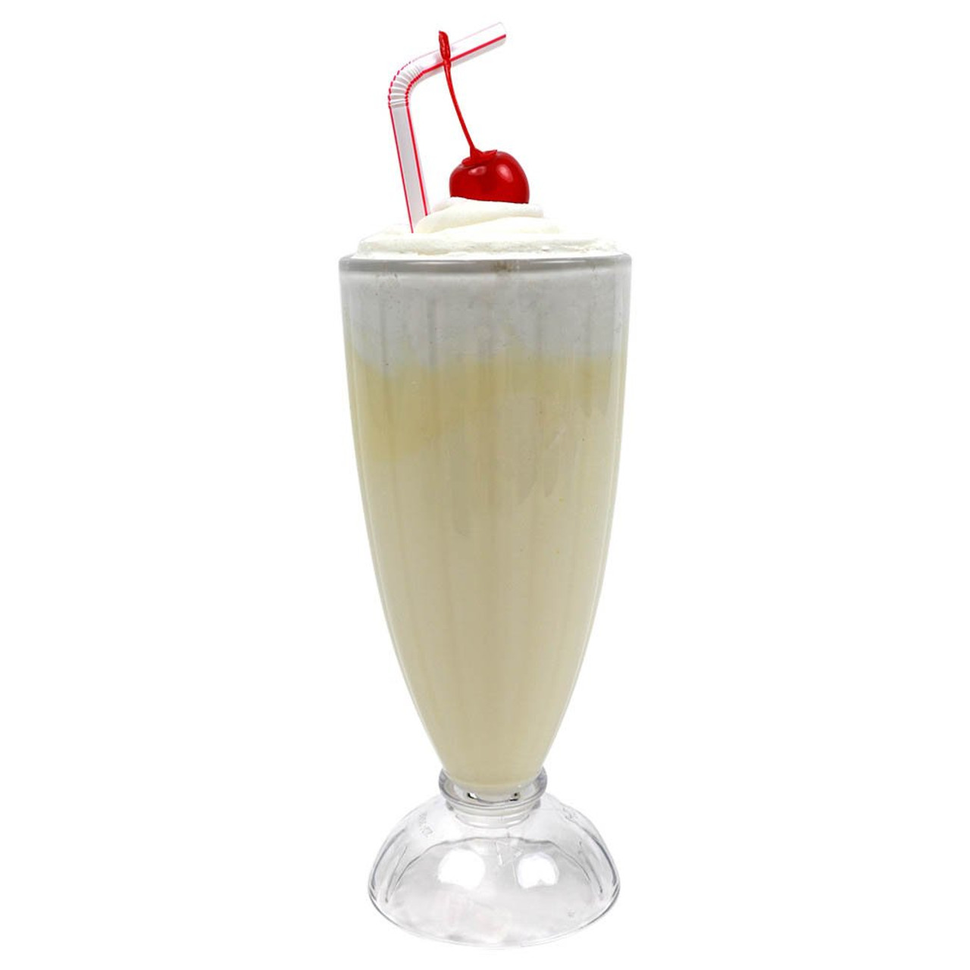
Postingestive Dopamine Response to Ultra-processed Food?
N = 50
BMI = 20-45 kg/m² PET ¹¹C-raclopride
Pre & Post
420 kcal
Ultra-processed milkshake
High in fat & sugar
P=0.62
No significant change in
brain dopamine, on average
VL Darcey et al. Cell Metabolism 37: 616–628 (2025).

Slide 14
TL Fazzino et al. Obesity 27:1761-1768 (2019).

Slide 15
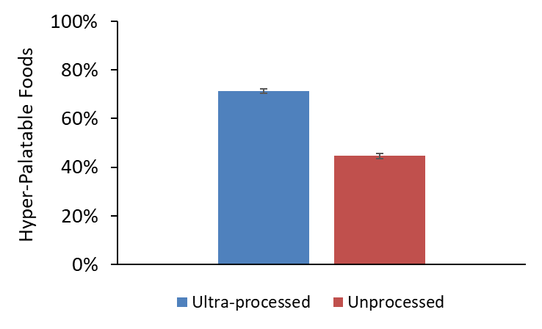
More Hyper-Palatable Foods in the Ultra-processed Meals
P<0.0001
Mean ± SE
TL Fazzino et al. Nature Food 4:144-147 (2023).

Slide 17
What Mediated the Ultra-processed vs Unprocessed Effect?
(N=20; 1635 Meals)
Hyper-palatable Foods
TL Fazzino et al.
Obesity 27:1761-1768 (2019)
Non-beverage Energy Density
L Johnson et al.
Obes Rev 10:681–692 (2009)
TL Fazzino et al. Nature Food 4:144-147 (2023).

Slide 18
New Study Ongoing: ClinicalTrials.gov NCT05290064
Compare ad libitum energy intake between 4 test diets provided for one week each in a randomized, counterbalanced sequence. All test diets are matched for macronutrients, fiber, sugar, and sodium:

Slide 19
New Study Ongoing: ClinicalTrials.gov NCT05290064
Compare ad libitum energy intake between 4 test diets provided for one week each in a randomized, counterbalanced sequence. All test diets are matched for macronutrients, fiber, sugar, and sodium:
Minimally processed diet low in non-beverage energy density & low in hyper-palatable foods (MPF ll)

Slide 20
New Study Ongoing: ClinicalTrials.gov NCT05290064
Compare ad libitum energy intake between 4 test diets provided for one week each in a randomized, counterbalanced sequence. All test diets are matched for macronutrients, fiber, sugar, and sodium:
Minimally processed diet low in non-beverage energy density & low in hyper-palatable foods (MPF ll)
Ultra-processed diet high in non-beverage energy density & high in hyper-palatable foods (UPF hh)

Slide 21
New Study Ongoing: ClinicalTrials.gov NCT05290064
Compare ad libitum energy intake between 4 test diets provided for one week each in a randomized, counterbalanced sequence. All test diets are matched for macronutrients, fiber, sugar, and sodium:
Minimally processed diet low in non-beverage energy density & low in hyper-palatable foods (MPF ll)
Ultra-processed diet high in non-beverage energy density & high in hyper-palatable foods (UPF hh)
Ultra-processed diet high in non-beverage energy density & low in hyper-palatable foods (UPF hl)

Slide 22
New Study Ongoing: ClinicalTrials.gov NCT05290064
Compare ad libitum energy intake between 4 test diets provided for one week each in a randomized, counterbalanced sequence. All test diets are matched for macronutrients, fiber, sugar, and sodium:
Minimally processed diet low in non-beverage energy density & low in hyper-palatable foods (MPF ll)
Ultra-processed diet high in non-beverage energy density & high in hyper-palatable foods (UPF hh)
Ultra-processed diet high in non-beverage energy density & low in hyper-palatable foods (UPF hl)
Ultra-processed diet low in non-beverage energy density & low in hyper-palatable foods (UPF ll)

Slide 23
Average Composition of the 7-day Menus
 | MPF ll | UPF hh | UPF hl | UPF ll
Three Daily Meals
Ultra-Processed Foods (% of energy) | 0 | 88 | 80 | 81
Hyperpalatable foods (% of energy) | 53 | 74 | 56 | 55
Non-beverage Energy Density (kcal/g) | 0.99 | 1.95 | 1.90 | 1.01
Energy Density (kcal/g) | 0.98 | 0.97 | 1.15 | 0.99
Carbohydrate (% of energy) | 46 | 47 | 46 | 45
Fat (% of energy) | 35 | 35 | 35 | 35
Protein (% of energy) | 19 | 18 | 19 | 20
Sodium (mg/1000 kcal) | 2247 | 1945 | 1891 | 2373
Fiber (g/1000 kcal) | 21 | 21 | 21 | 18
Sugars (g/1000 kcal) | 34 | 32 | 34 | 32

Slide 24
Baseline Participant Characteristics
 | Mean ± SD (min, max)
Males/ Females | 11/7
Age (y) | 33.6 ± 10.4 (19, 52)
Height (cm) | 172.8 ± 8.0 (158, 185)
Body Weight (kg) | 86.9 ± 18.1 (61.7, 119.1)
BMI (kg/m²) | 29.0 ± 5.4 (20.8, 41.8)
Fat Mass (kg) | 29.2 ± 15.6 (6.8, 66.1)
% Body Fat | 32.4 ± 12.8 (10.2, 55.5)
Unpublished Interim Analysis (N=18/36): ClinicalTrials.gov NCT05290064

Slide 25
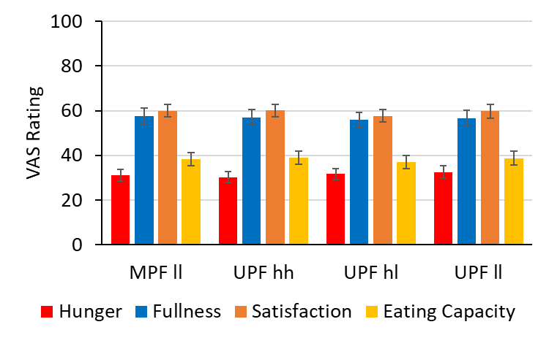
No Significant Differences in Appetite Ratings
Mean ± SE
Unpublished Interim Analysis (N=18/36): ClinicalTrials.gov NCT05290064

Slide 26
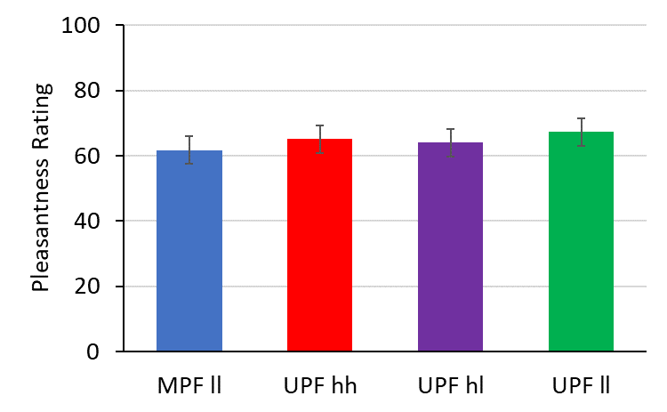
No Significant Differences in Meal Pleasantness Ratings
Mean ± SE
Unpublished Interim Analysis (N=18/36): ClinicalTrials.gov NCT05290064

Slide 27
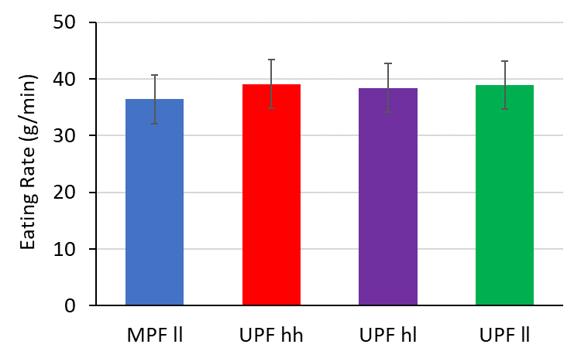
No Significant Differences in Meal Eating Rate
Mean ± SE
Unpublished Interim Analysis (N=18/36): ClinicalTrials.gov NCT05290064

Slide 28
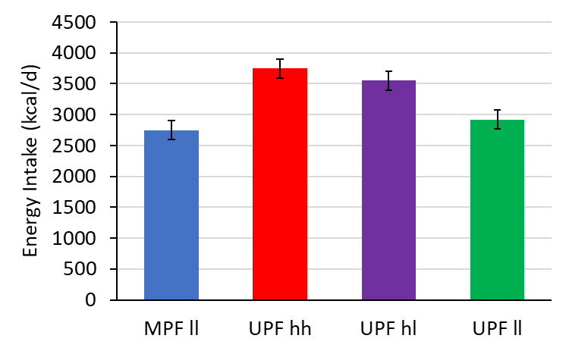
Primary Outcome: Ad Libitum Energy Intake Differences
Δ ~170 kcal/d
P=0.11
Δ ~200 kcal/d
P=0.07
Δ ~1000 kcal/d
P<0.0001
Δ ~630 kcal/d
P<0.0001
Mean ± SE
Unpublished Interim Analysis (N=18/36): ClinicalTrials.gov NCT05290064
Notes:
Label Estimate StdErr DF tValue Probt
MPFll 2500.17 157.05 42.00 15.92 2.1273E-19
UPFhh 3496.06 157.05 42.00 22.26 7.14303E-25
UPFhl 3300.46 157.05 42.00 21.02 6.59961E-24
UPFll 2672.18 157.05 42.00 17.02 1.87718E-20
UPFhh vs MPFll 995.89 104.74 42.00 9.51 4.94492E-12
UPFhh vs UPFhl 195.61 104.74 42.00 1.87 0.06881105
UPFhh vs UPFll 823.89 104.74 42.00 7.87 8.61565E-10
UPFhl vs UPFll 628.28 104.74 42.00 6.00 3.99205E-07
UPFll vs MPFll 172.01 104.74 42.00 1.64 0.108004929

Slide 29
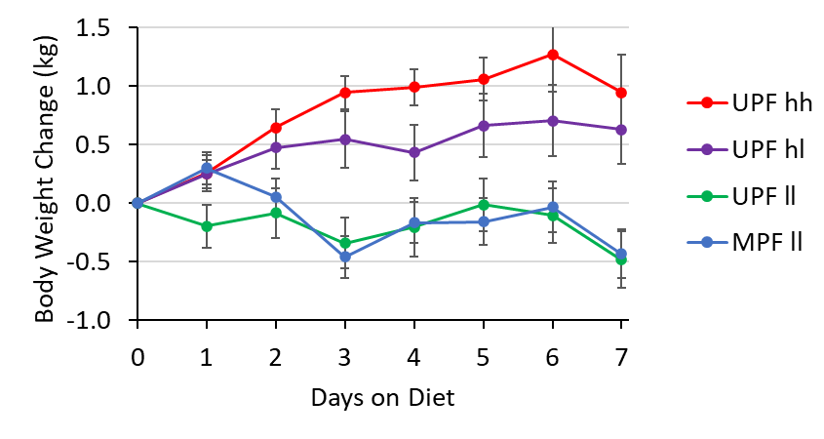
Weight Changes Correspond to Energy Intake Differences
Mean ± SE
Unpublished Interim Analysis (N=18/36): ClinicalTrials.gov NCT05290064

Slide 30
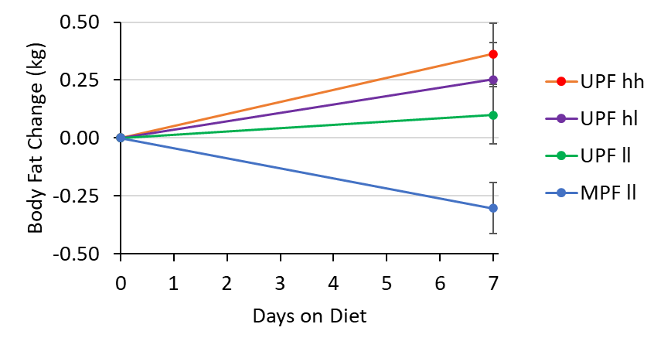
Only the Minimally Processed Diet Led to Body Fat Loss
Mean ± SE
Unpublished Interim Analysis (N=18/36): ClinicalTrials.gov NCT05290064

Slide 31
Ultra-processed Food Mechanisms: Beyond Obesity
KA Maki et al. Nat Rev Immunol 24:453-4 (2024).

Slide 32
Special Thanks
MCRU Nursing Staff
NIH Nutrition Department
(Sara Turner & Shanna Yang)
Volunteer Study Participants
Intramural NIDDK
Zoha Acqeel
Alexis Ayuketah
Robert Brychta
Kong Chen
Meible Chi
Stephanie Chung
Christopher Colvin
Elise Costa
Amber Courville
Valerie Darcey
Jenna Feeley
Isabelle Gallagher
Emma Grindstaff
Juen Guo
Rebecca Howard
Melissa La Noire
Susanne McGehee
Katherine McNeel
Lauren Milley
Collaborators
Tera Fazzino (U Kansas)
Ciaran Forde (Wageningen)
Paule Joseph (NIAAA)
Katherine Maki (NIH CC)
Michael Sack (NHLBI)
Jude Ong
Klaudia Raisinger
Irene Rozga
Sanaz Sakiani
Alex Schick
Michael Stagliano
Nick Urbanski
Mary Walter
Peter Walter
Nan Zhai
Megan Zhou
Funders
Intramural Research Program of the National Institutes of Health, NIDDK

