Slide 1
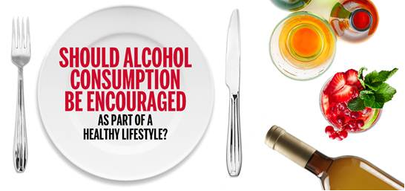
US Dietary Guidelines and
Labelling
Timothy S. Naimi M.D., M.P.H.
Director, Canadian Institute for Substance Use Research

Slide 2
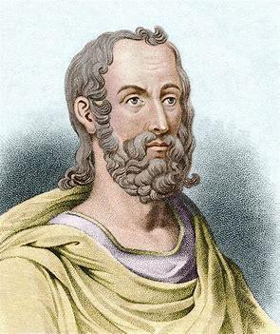
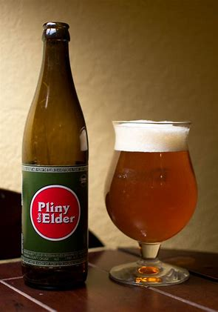
Pliny the Elder, 1st C., Rome
"It is hard to say whether wine does good to more people than it harms...
medical opinion is very divided"
Notes:
So the topic of my talk is a controversial one. And we can go way back to Pliny the Elder….

Slide 3
Bottom Line
There are many reasons why people drink
On balance, alcohol an unhealthy substance
For most, low-volume alcohol can be used with low risk; but risk of death increases above 1 drink/d

Slide 4
Final Recommendations: U.S. DG Advisory Committee
Do not drink alcohol because you think it will make you healthier (adopted/retained)
If you drink alcohol, drinking less is better for health than drinking more (adopted)
For those who drink, recommended limits are 1 drink per day for women and men on days when alcohol is consumed (not adopted, 2/1 limits retained)
Notes:
issues: not popular, already not followed, therefore aspirational for many

Slide 5
What Changed?
All-cause mortality: higher risk at 2 than 1
Limitations of existing studies
Still no randomized trials …
Mendelian randomization: no protection of ‘moderate’ drinking against heart attacks, strokes
Alcohol and cancer, even at low doses
1-2 drinks/day: similar risks for men and women
Notes:
issues: not popular, already not followed, therefore aspirational for many

Slide 6
The Precautionary Principle
Notes:
we’ll discuss two methodological issues with regard to the observational evidence base: confounding and selection bias,. Biggest threats…

Slide 7
Alcohol
Leading cause of death, costs
Second hand effects, social problems
Carcinogen
No nutritional value … except calories
Minimal labelling requirements ??
Notes:
issues: not popular, already not followed, therefore aspirational for many

Slide 8
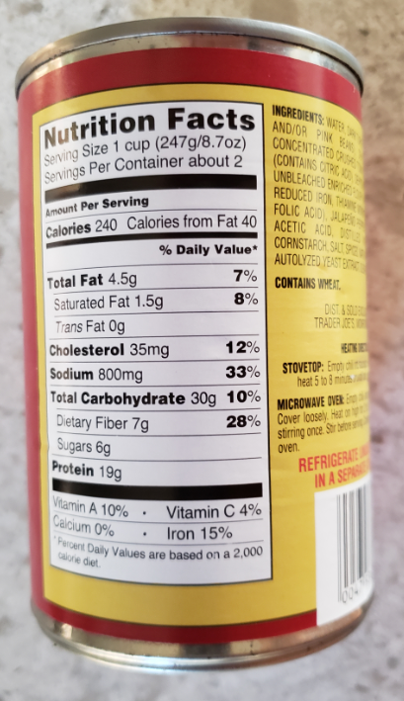
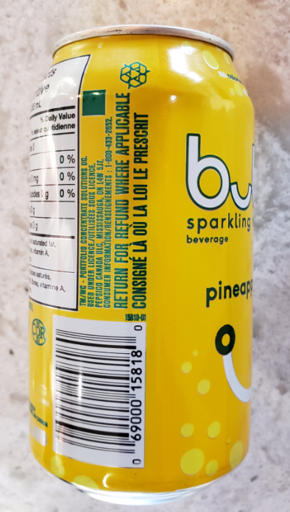
Turkey Chili, Flavored Water

Slide 9
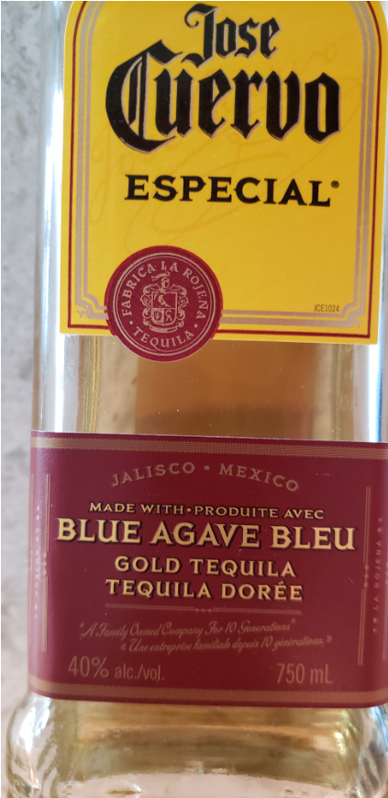
Tequila

Slide 10
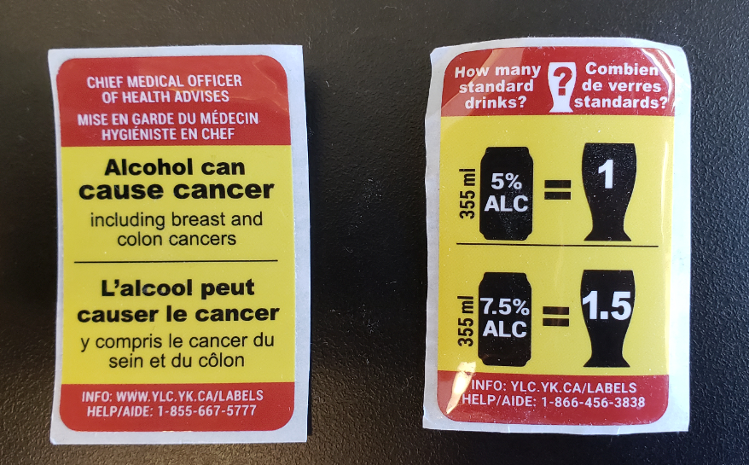
Drink Size, # Drinks per Bottle, # Calories per Drink, Health Info

