Slide 1
Modernization of Performance Standards
Photos: Alison Marras, PhotosTheArt via Unsplash
Sarah Sorscher, JD, MPH, Deputy Director
Center for Science in the Public Interest
March 11, 2021
Notes:
Roast Photo by Alison Marras on Unsplash , Farm Photo by PhotosTheArt on Unsplash

Slide 2
Center for Science in the Public Interest America’s Food & Health Watchdog
Photo credit: jessibot
Major Victories:
Nutrition Labeling Education Act
Nutrition Facts updates
Menu Labeling
School Foods Nutrition Standards
Food Safety Modernization Act
Notes:
Photo credit: jessibot

Slide 3
Healthy People 2020 Targets: How Did We Do?...
 | Incidence per 100,000 in 2006-08 | Incidence per 100,000 Healthy People Target | Incidence per 100,000 in 2019*
Campylobacter | 12.7 | 8.5 | 19.5
Salmonella, nontyphoidal | 15.0 | 11.4 | 17.1
E. Coli (STEC) O157 | 1.2 | 0.6 | 6.3
Listeria monocytogenes | 0.3 | 0.2 | 0.3
Tack DM, et al. “Preliminary Incidence and Trends of Infections with Pathogens Transmitted Commonly Through Food – Foodborne Diseases Active Surveillance Network, 10 U.S. Sites, 2016-2019, MMWR. 69(17);509-514.

Slide 4
… Not Good.
“These data indicate that Healthy People 2020 targets for reducing foodborne illness will not be met. The identification of infections that might not have been detected before adoption of CIDTs cannot explain this overall lack of progress. Better implementation of known prevention approaches and new strategies is needed to overcome the continued challenges to reducing foodborne illnesses.”
- Tack et al, 2019

Slide 5
Where Should USDA Target New Efforts?
Pathogen | Food | No. of Illnesses | Cost (billions) | Rank
Campylobacter | Unspecified Poultry | 608,417 | 6.9 | 1
Salmonella, NT | Chicken | 195,634 | 2.8 | 2
Salmonella, NT | Pork | 133,252 | 1.9 | 3
Toxoplasma gondii | Pork | 35,541 | 1.9 | 4
T. gondii | Beef | 20,111 | 1.0 | 5
Scharff RL. Food Attribution and Economic Cost Estimates for Meat and Poultry-Related Illnesses. Journal of Food Protection. 2020; 83(6): 959-967.

Slide 6
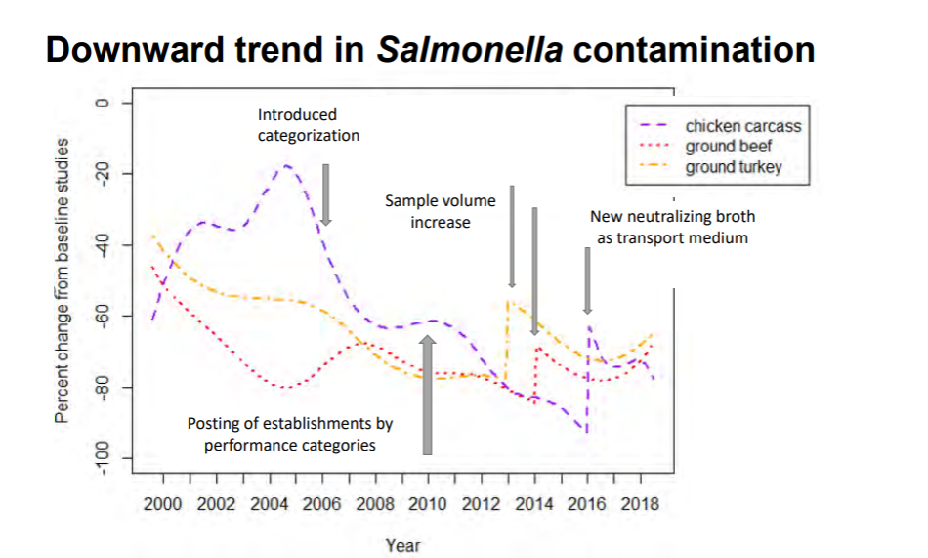
Performance Standards Are Having an Effect
Hale KR. Salmonella Trends –What the Science Tells Us. Oral presentation at: USDA FSIS Virtual Public Meeting: Salmonella-State of the Science; September 2020. (Slide 93)

Slide 7
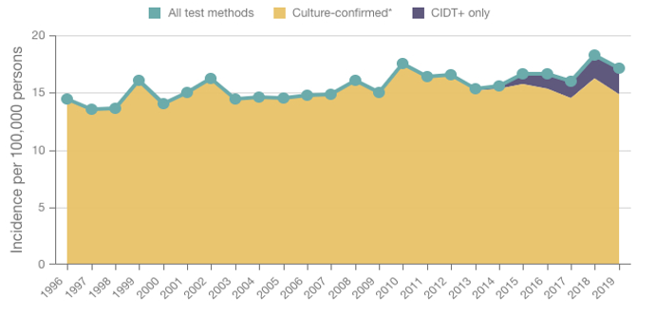
But Is It the Right Effect?
Chicken Parts Standard
Pathogen Surveillance - Salmonella. Centers for Disease Control and Prevention website. Accessed January 6, 2021. https://wwwn.cdc.gov/foodnetfast

Slide 8
Criticisms of the Standards
Focused on all Salmonella, with no risk assessment for dose, virulence, resistance.
Exclusive focus on end-product testing incentivizes chemical interventions, rather than a more comprehensive supply chain approach.
Lack of enforceability: products are not considered adulterated until after they are connected to an outbreak.

Slide 9
Lack of Risk Assessment: We Do the Most Enforcement for Salmonella that Do the Least Harm
HACCP Samples
Clinical Samples
Profile of Serotypes from Analyzed PR/HACCP Verification Samples (top 5 individual serotypes in 2014 reported), Young Chicken (Broilers), by Year
Incidence Rate of Culture-Confirmed Human Salmonella Infection Reported to Laboratory-based Enteric Disease Surveillance (LEDS) System (top 7 individual serotypes in 2014 reported), by Year, United States.

Slide 10
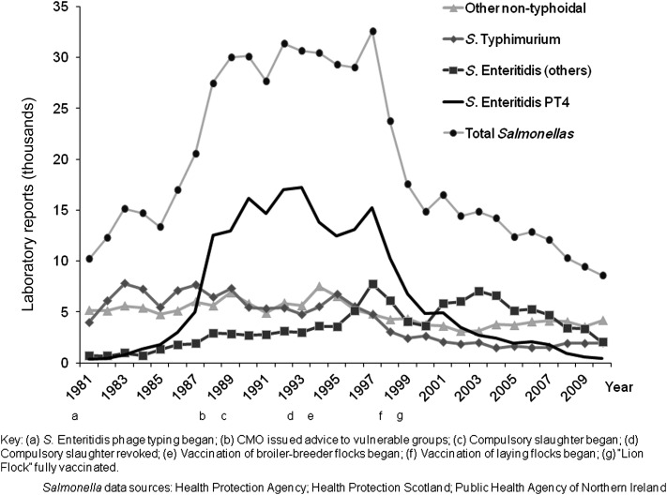
It is possible to bring case counts down: UK Example
O'Brien SJ. The "decline and fall" of nontyphoidal Salmonella in the United Kingdom. Clin Infect Dis. 2013; 56(5): 705-710.

Slide 11
What’s Happening In Europe?
National Action Plans target priority serotypes
Enforceable standards
Some priority serotypes are adulterants in raw meat and poultry
Farm-to-fork regulatory coverage
Including on-farm targets, surveillance, and control programs

Slide 12
US Example
Presentation by Rob Tauxe, MD, MPH, Director, Division of Foodborne, Waterborne, and Env. Dis., NCEZID, CDC. Road Map to Reducing Salmonella, September 22, 2020

Slide 13
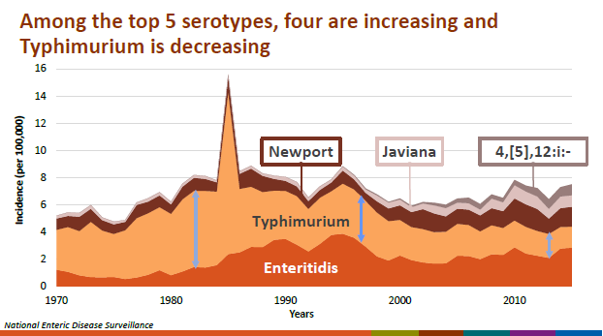
But… A Static, Piecemeal Approach Leaves Gaps
Presentation by Rob Tauxe, MD, MPH, Director, Division of Foodborne, Waterborne, and Env. Dis., NCEZID, CDC. Road Map to Reducing Salmonella, September 22, 2020

Slide 14
Reactive Strategy Adapts Too Slowly to Emerging Strains
Example: Multidrug Resistant S. Infantis
MDR S Infantis strain first seen in travelers from Peru in 2021
Resistant to 10 agents, including common first-line treatments
First chicken case 2013
First domestically-acquired human case in 2014
Spread rapidly 2017-2018
2019: 30% of S Infantis in humans is MDR
Adapted from: Presentation by Rob Tauxe, MD, MPH, Director, Division of Foodborne, Waterborne, and Env. Dis., NCEZID, CDC. Road Map to Reducing Salmonella, September 22, 2020

Slide 15
Industry Experts Agree… the System is Broken
“Not all Salmonella are created equal and not all product positives will result in illness… Assessing only prevalence on all serovars will not target high-risk Salmonella serovars and, therefore, not likely reduce the number of possible illnesses.”
– North American Meat Institute, Comment RE: Salmonella-State of the Science, Docket No. FSIS-2020-0025.
“Consumers are better protected from illness under a risk-based approach that focuses on the Salmonella serovars exhibiting the higher risk for pathogenicity that are found on products at higher levels.”
– National Cattlemen’s Beef Association, Comment RE: Salmonella-State of the Science, Docket No. FSIS-2020-0025.

Slide 16
Petition - 2021
Submitted by
Center for Science in the Public Interest(CSPI)
STOP Foodborne Illness (STOP)
Consumer Federation of America (CFA) Consumer Reports (CR)
Five individual victims of foodborne illness
Two of these groups, CR and CFA, also signed the earlier petition by Bill Marler to declare 31 Salmonella serotypes to be adulterants in meat and poultry

Slide 17
Consumer’s Vision for Better Standards
What Should They Do?:
Enforceable and risk-based
Ensure Best Practices from Farm-to-Fork
Adaptable to evolving science and novel threats

Slide 18
Consumer’s Vision for Better Standards
What Should They Be?:
Enforceable, risk-based standards
Targeting Salmonella types of greatest public health concern and Campylobacter
Possibility for quantification testing
Supply Chain Controls
Applying HACCP principles
Future Evolution:
Virulence factors, quantitative assessments, emerging threats

Slide 19
Remaining Questions
What are the most important criteria for assessing risk? Are these adequately incorporated into the current standards?
What are the most important tools for controlling risk? Are these adequately incentivized under the current regulatory standards?
What would a regulatory standard that is truly based on risk look like?
What are the scientific questions that would have to be answered to support such a standard?
What are the challenges for implementing such a standard?

Slide 20
ssorscher@cspinet.org

