Slide 1
Hardships of COVID-19: Spotlight on Food Insecurity
Sara N. Bleich, PhD
National Food Policy Conference
October 15, 2020

Slide 2
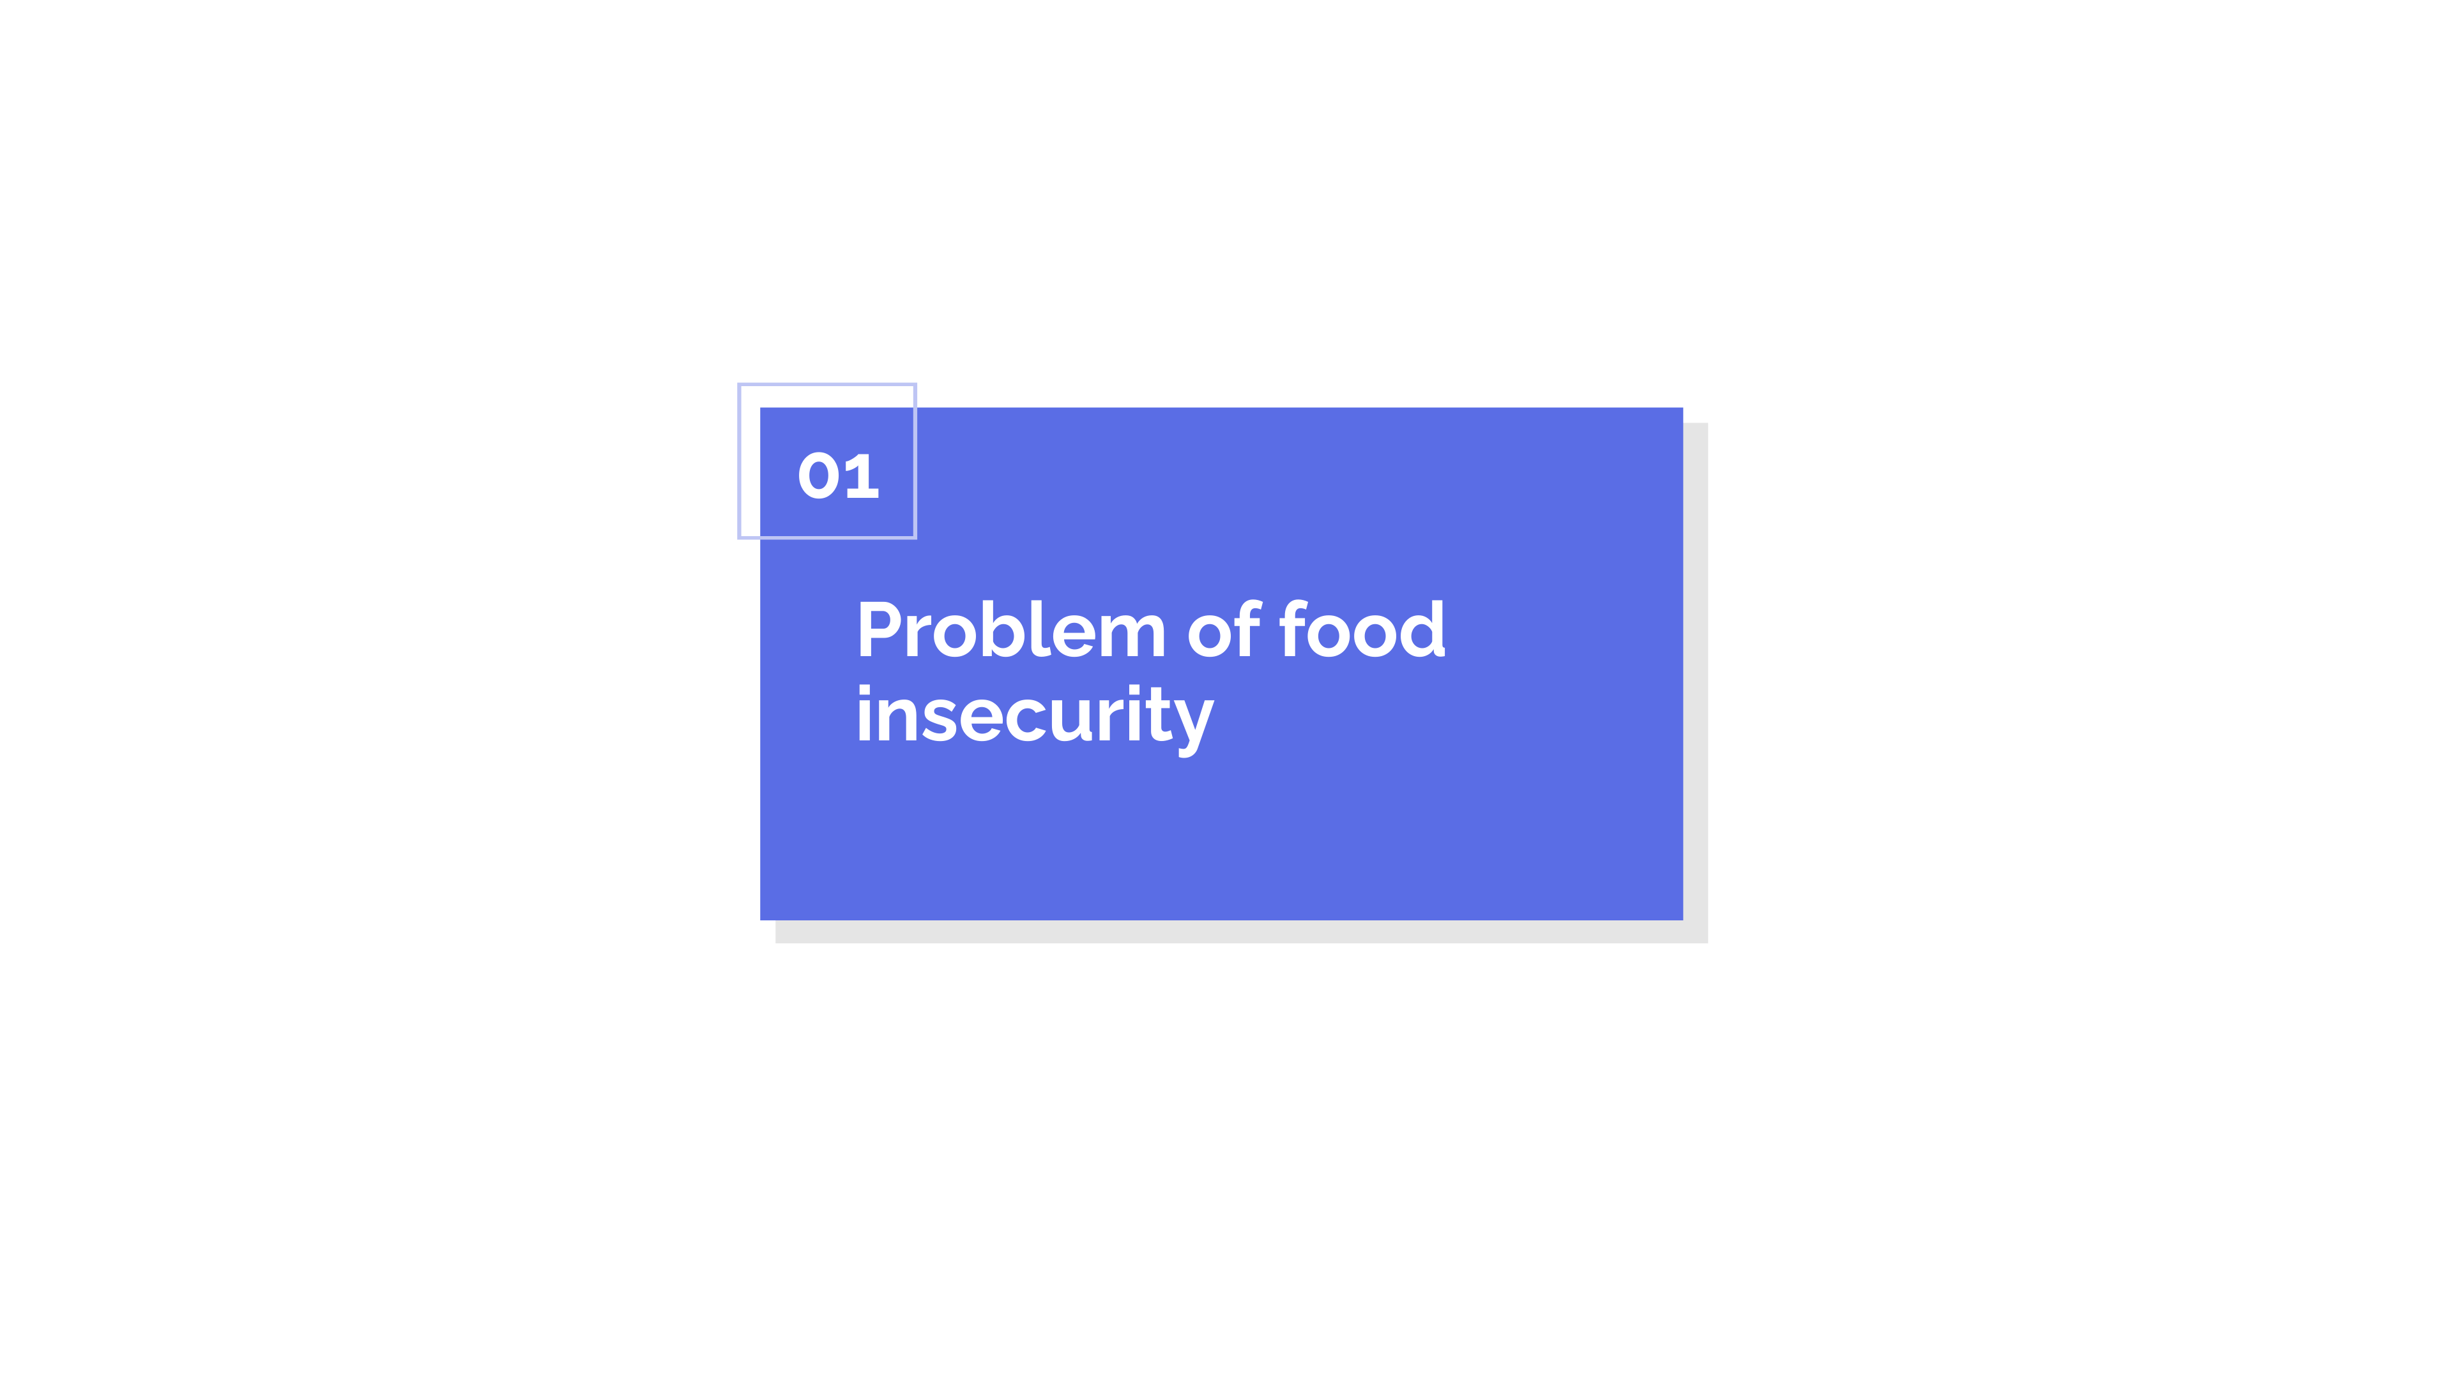
Problem of food insecurity

Slide 3
Before the pandemic, food insecurity had been declining for more than a decade
Notes:
.

Slide 4
But there were large and persistent disparities by race and ethnicity

Slide 5
Dramatic increase in food insecurity due to COVID-19
Pre-pandemic
10.5% were food insecure
During the pandemic
23% are food insecure

Slide 6
Large disparities in food insecurity by race/ethnicity
Pre-pandemic
Black: 19% were food insecure
Latinx: 16% were food insecure
White: 8% were food insecure
During the pandemic
Black: 36% were food insecure
Latinx: 32% were food insecure
White: 18% were food insecure
36%
32%
% of households with food insecurity
19%
18%
16%
8%

Slide 7
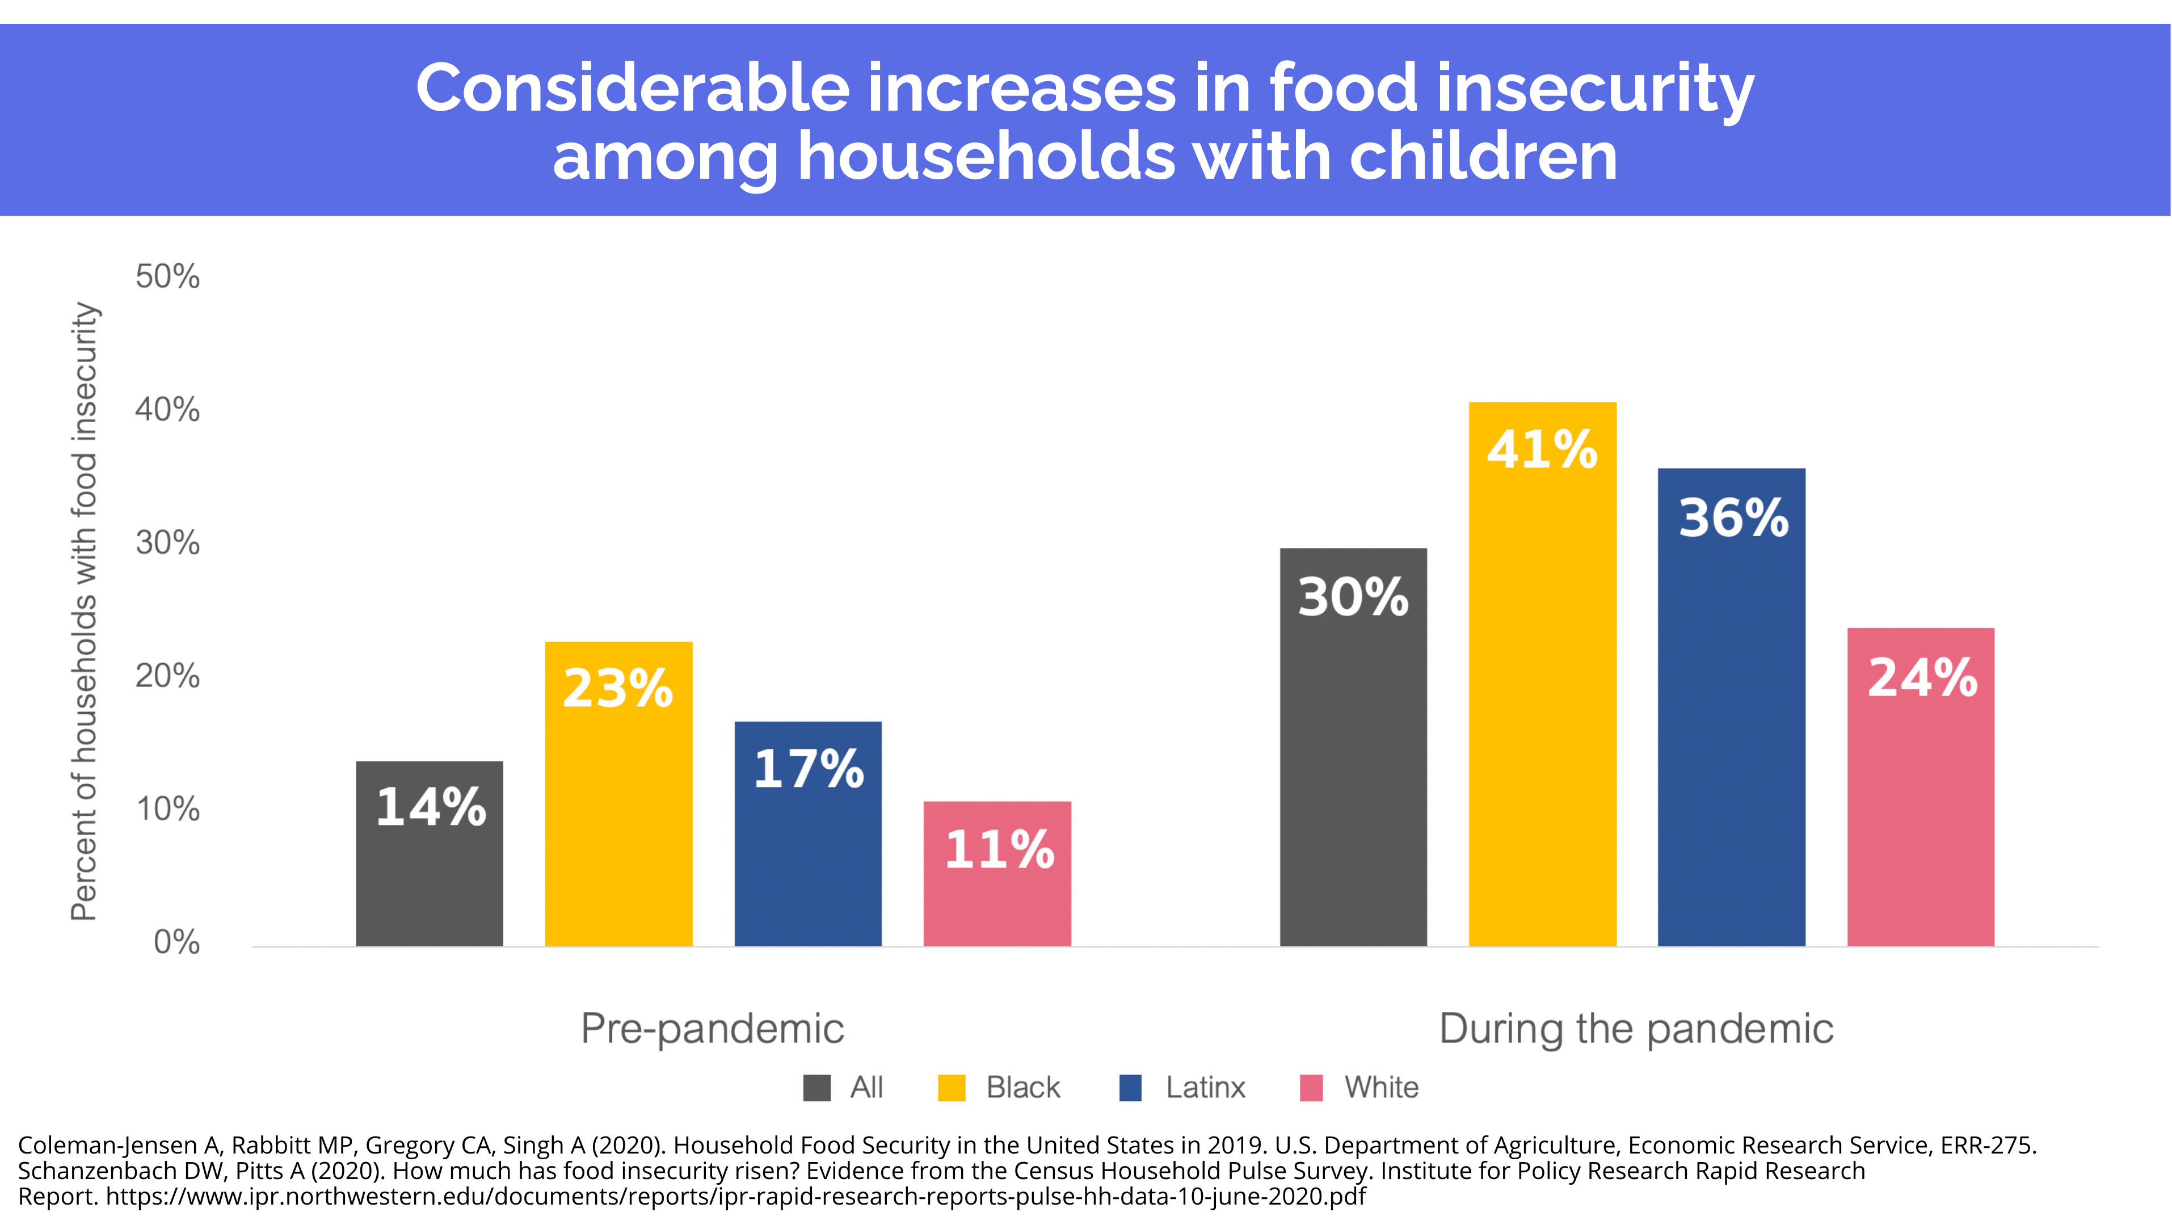
Considerable increases in food insecurity among households with children
Pre-pandemic
All households with children: 14%
Black households with children: 23% were food insecure
Latinx households with children: 17% were food insecure
White households with children: 11% were food insecure
During the pandemic
All households with children: 30%
Black households with children: 41% were food insecure
Latinx households with children: 36% were food insecure
White households with children: 24% were food insecure
41%
36%
Percent of households with food insecurity
30%
23%
24%
17%
14%
11%
All
Black
Latinx
White

Slide 8
Millions of Americans live in food deserts
People who live in food deserts are often more likely to experience food insecurity because food is harder to obtain
About 19 million people, or roughly 6% of the population, live in a food desert
2.1 million households both lived in a food desert and lacked access to a vehicle in 2015

Slide 9
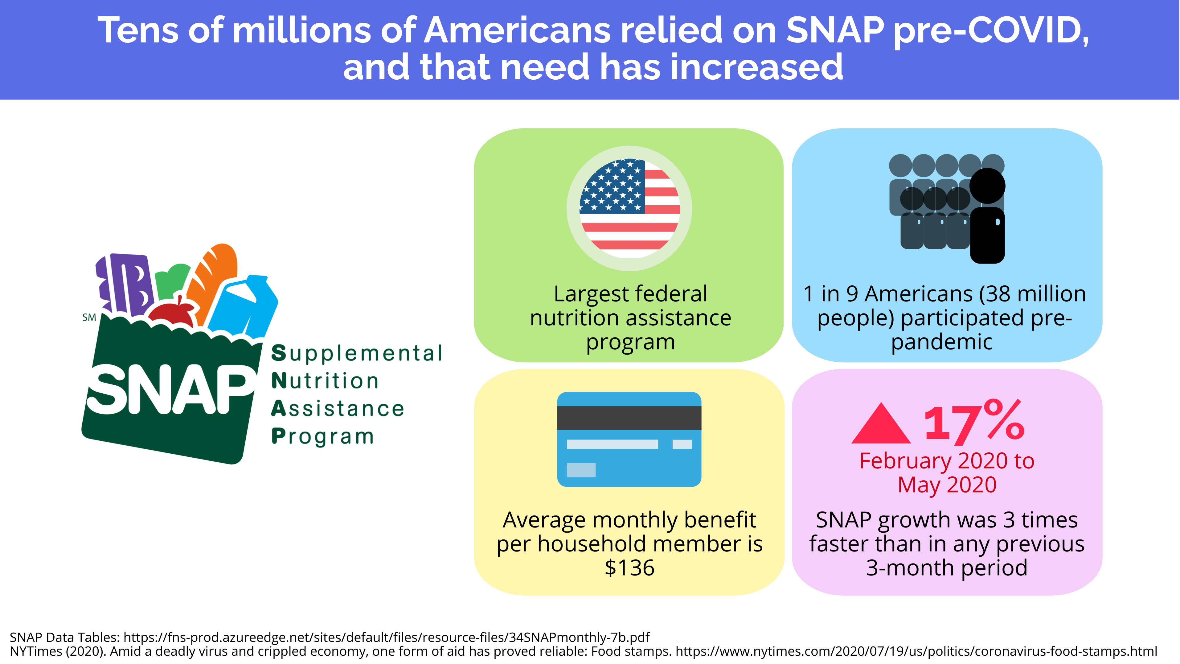
Tens of millions of Americans already relied on SNAP and need has increased
Supplemental Nutrition Assistance Program
Largest food assistance programs in the country
38 million people pre-pandemic (1 in 9 Americans)
Average monthly benefit for each member of a household is $129 or $1.40 per person per meal
SNAP grew by 17% from February 2020 to May 2020, three times faster than in any previous three-month period

Slide 10
Other hardships

Slide 11
Source: Department of Labor. By: The New York Times.

Slide 12
Job losses are higher among racial/ethnic minorities and concentrated in low-paid industries
Unemployment rate August: 8.4%
Black workers: 13.0 percent
Latino workers: 10.5 percent
White workers: 7.3 percent
Lowest-paying industries accounting for 30% of all jobs but 51% of the jobs lost from February to August
Jobs in low-paying industries were down almost twice as much between February and August 2020 (12.9 percent) as jobs in medium-wage industries (7.4 percent) and three times as much as in high-wage industries (4.5 percent), compared to 8% decline across all industries

Slide 13
Job recovery is much slower for racial/ethnic minorities

Slide 14
Millions are having difficulty paying rent
13 million adults (17%) living in rental housing were behind on rent in early September (1 in 6 renters)
1 in 4 Black (25 percent)
1 in 4 Asian (24 percent)
1 in 5 Latino (22 percent)
1 in 9 White (12 percent)
1 in 4 with children (25 percent)
Combination of rental hardship and food hardship is hurting children
39% of children living in rental housing live in a household that either isn’t getting enough to eat or is not caught up on rent

Slide 15
Struggles for households with children
More than 60 percent of US households with children report serious financial problems during pandemic
Struggles to afford medical care
depletion of household savings
Difficulty paying credit card and other debts
Black and Latinx households with children bear the brunt of the hardships
Latinx households: 86 percent reported these difficulties
Black households: 66 percent reported these difficulties
White households: 50% reported these difficulties

Slide 16
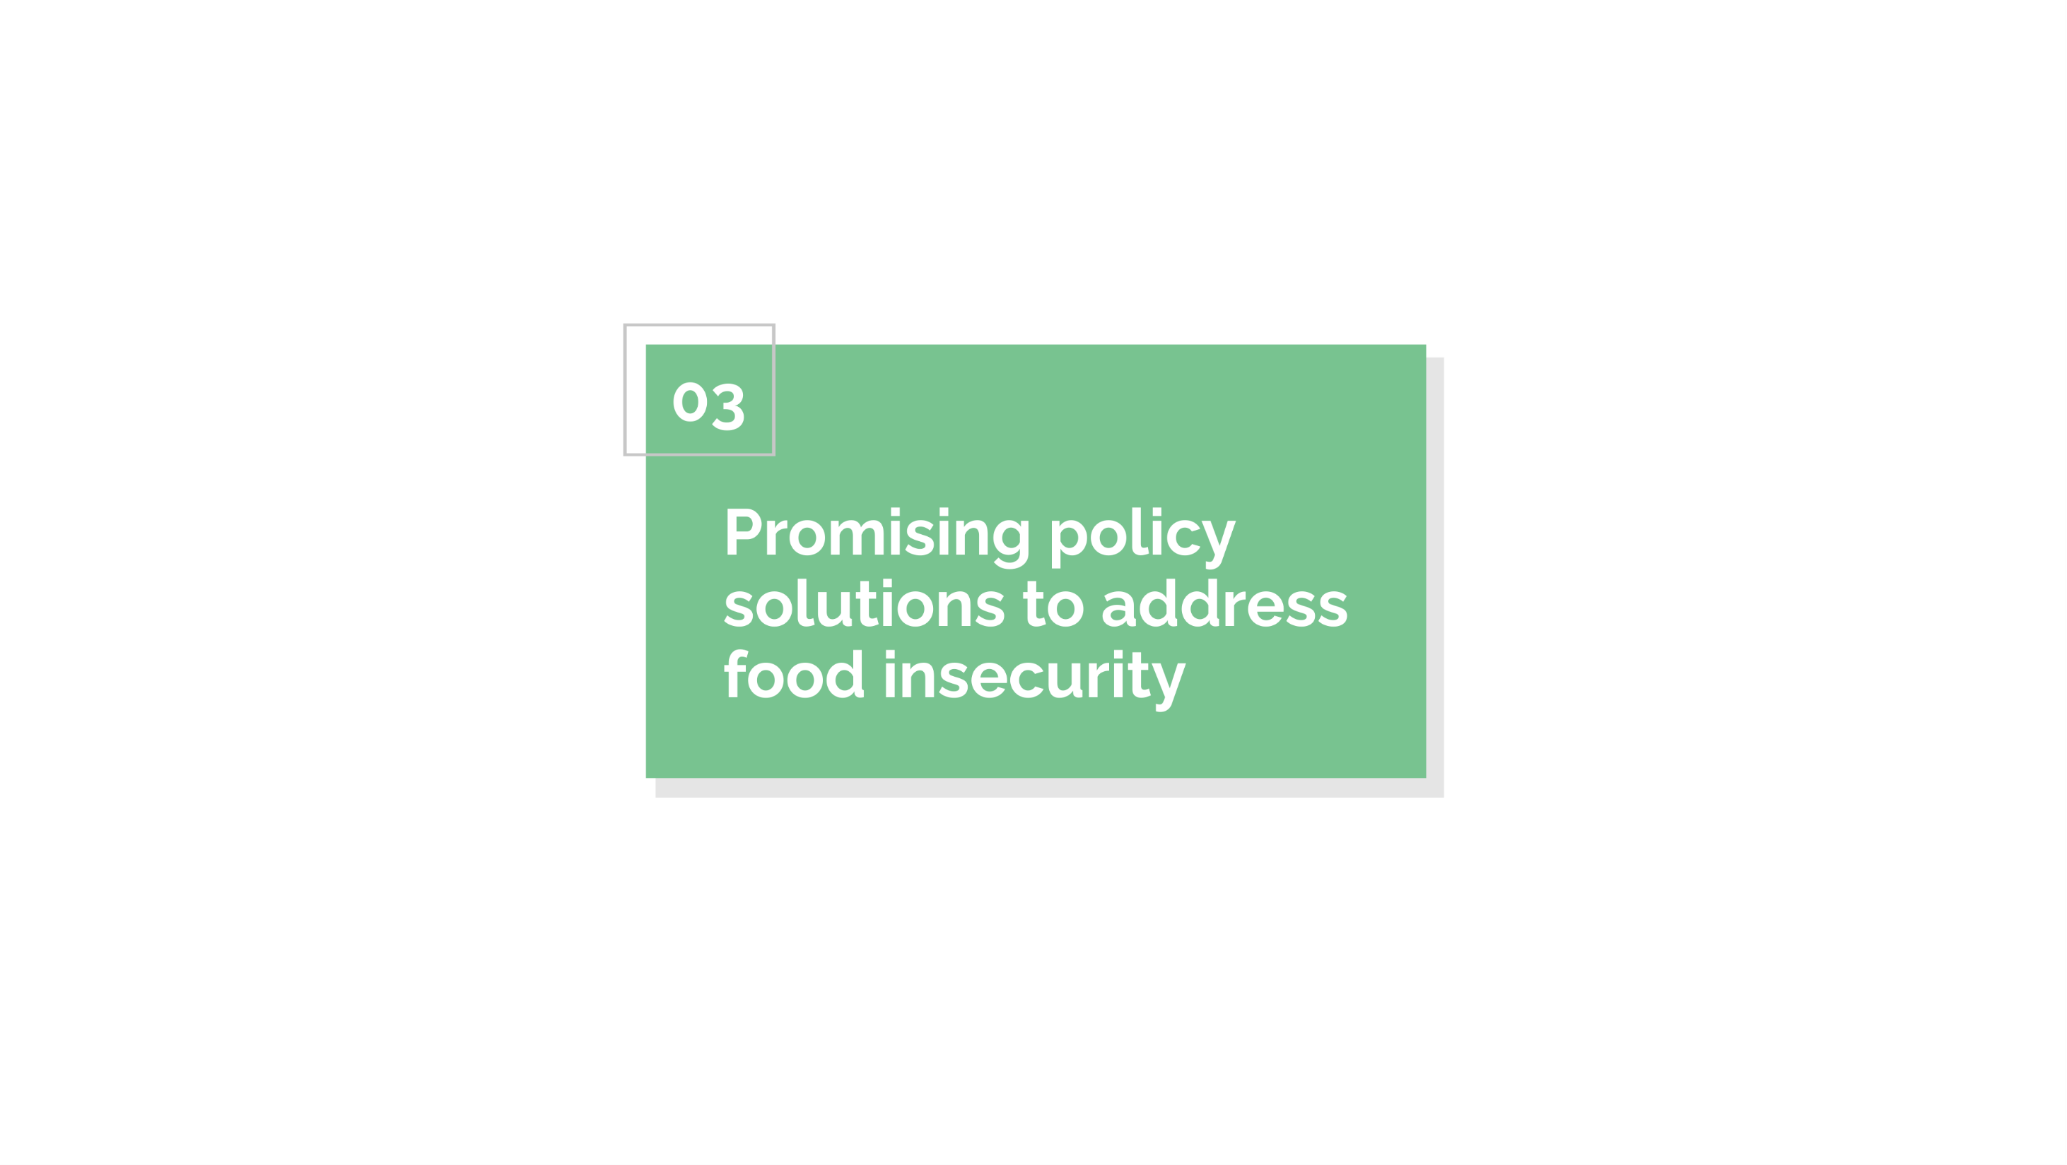
Promising policy solutions to address food insecurity

Slide 17
Policies that increase the value of the SNAP allotment
Continue emergency allotment
Increase monthly SNAP benefits by 15 percent ($100 per month for a family of four)
Extend P-EBT until schools closures end

Slide 18
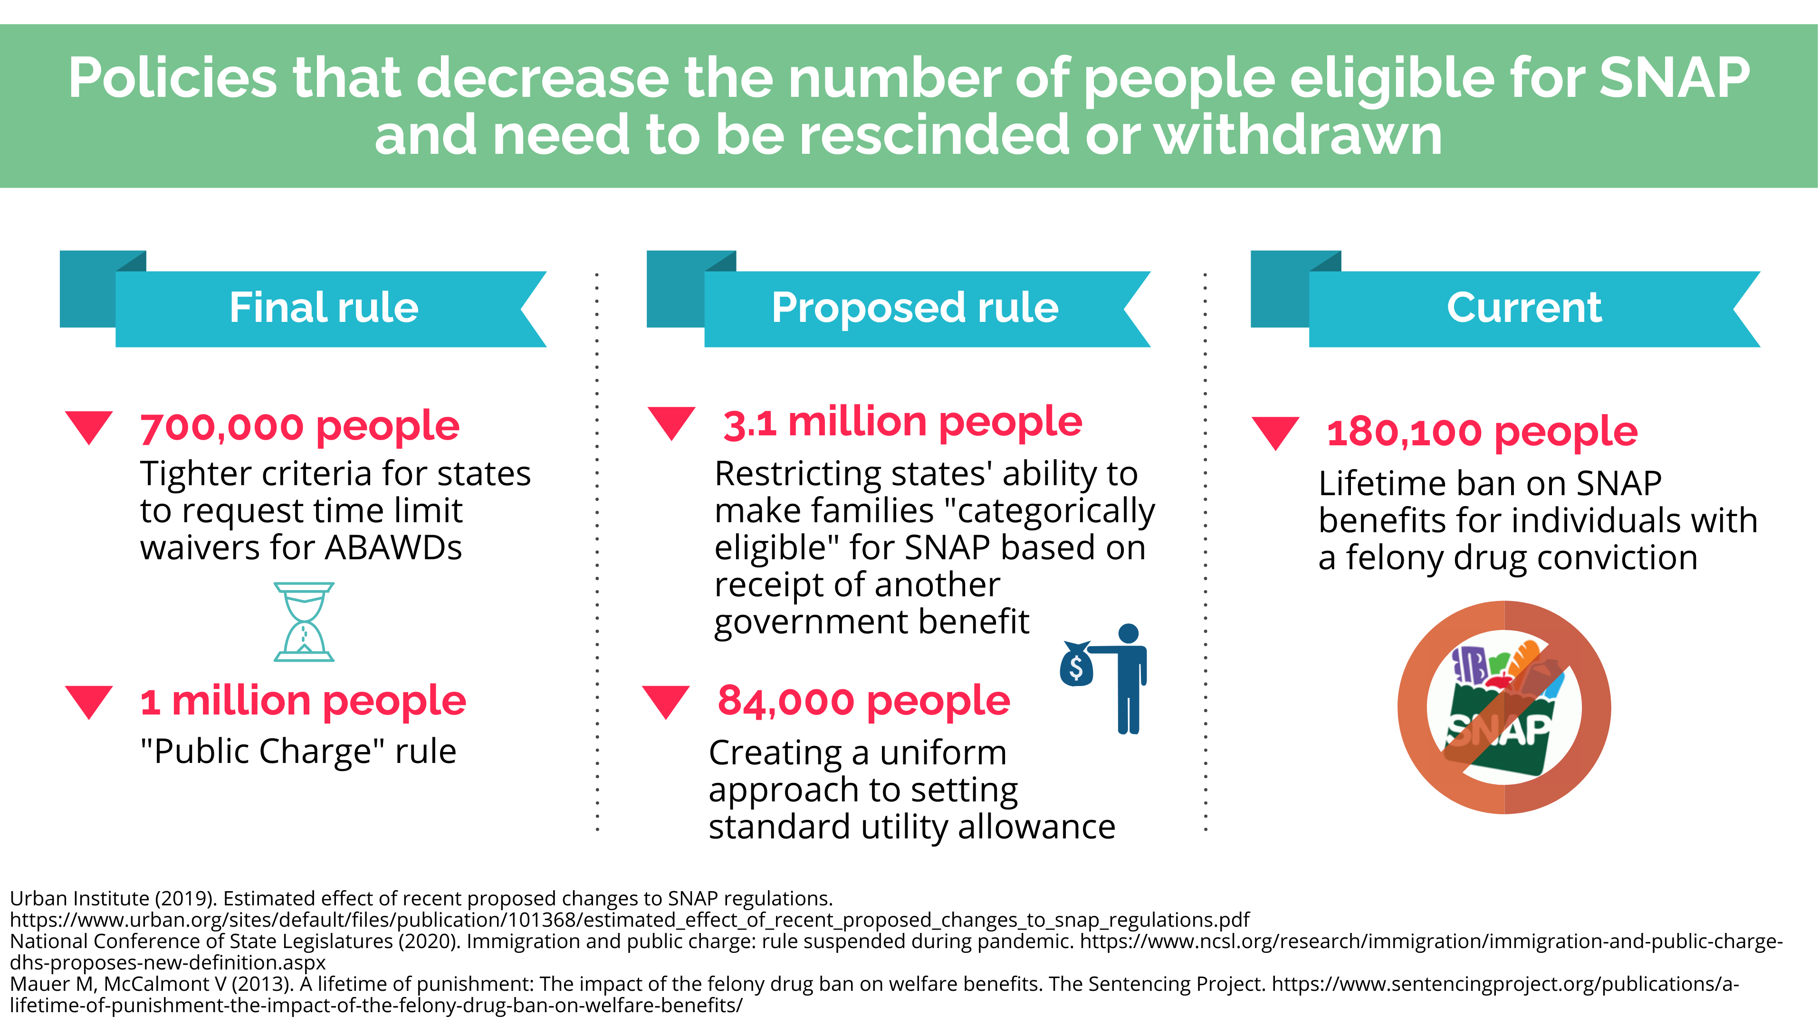
Policies that decrease the number of people eligible for SNAP and need to be halted
Tightened criteria for states to request time limit waivers for ABAWDs – expected to reduce participation by ~700,000 people (delayed)
Restricting states’ ability to make families “categorically eligible” for SNAP based on receipt of another government benefit – expected to reduce participation by 3.1 million people (proposed rule)
‘Public Charge’ rule – expected to reduce participation by ~ 1 million (delayed)
Creating a uniform approach to setting standard utility allowance – expected to reduce participation by 84,000 (proposed rule)
Lifetime ban on SNAP benefits for individuals with a felony drug conviction should be repealed

Slide 19
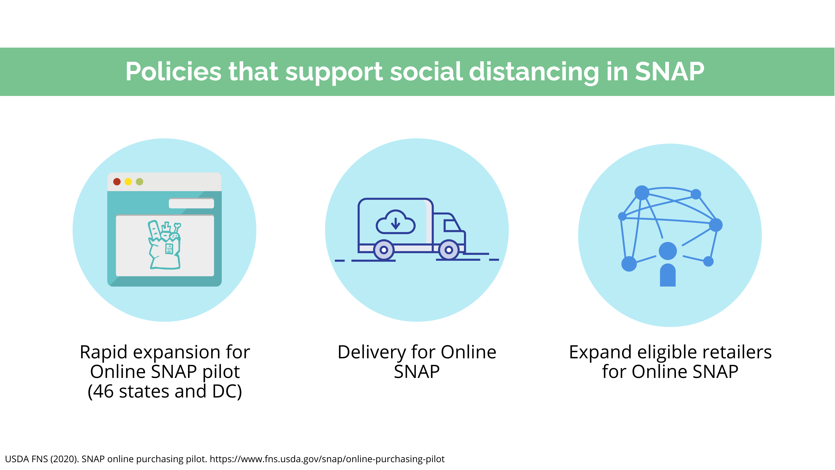
Policies that support social distancing in SNAP
Online SNAP pilot – Rapid expansion and now up to 46 states
Delivery For Online SNAP
Expand eligible retailers for Online SNAP

Slide 20
Policies that can increase the reach of other nutrition assistance programs
School meals
Schools are currently allowed to serve free meals to all children through 12/31 – this should be permanent
WIC
Expand the ability to use WIC benefits online
Increase WIC benefits by boosting the fruit and vegetable cash value vouchers which currently range from $8 to $11
Increase WIC benefits:

Slide 21
Other important areas where federal action is needed
Continue fiscal stimulus
Reabsorb displaced workers and the long-term unemployed into the labor force as fast as possible
Reduce unemployment gaps between Black and white Americans
Help working women manage child care

Slide 22
Key takeaways
COVID-19 is continuing to spread
Negative health impacts and economic fallout of the pandemic are widespread and particularly prevalent among low income and minority communities
Disproportionate impacts reflect longstanding inequities — often stemming from structural racism — in education, employment, housing, and health care that the current crisis is exacerbating
Proven policies approaches are needed and some policies need to be halted maximize program impact and reduce food insecurity

