Slide 1
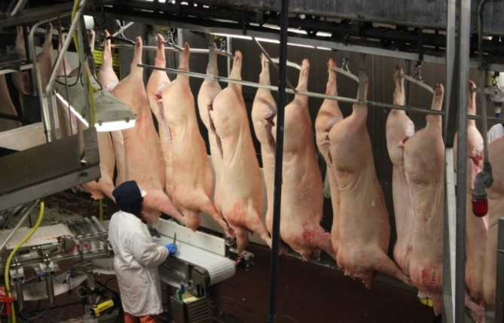
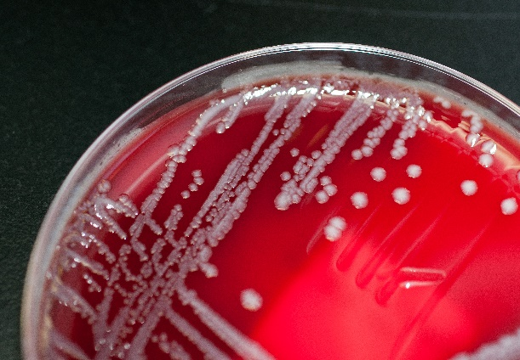
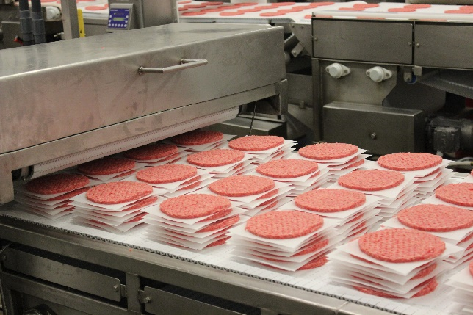
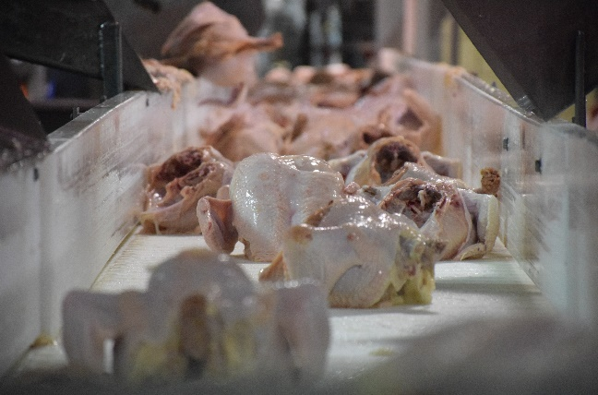
Office of Food Safety
Protecting Public Health and Preventing Foodborne Illness

Slide 2
National Food Policy
Conference
March 15, 2019
Mindy Brashears, Ph.D.
Deputy Under Secretary for Food Safety

Slide 3
Cell-Cultured Food Products
From Cell Lines of
Livestock and Poultry

Slide 4
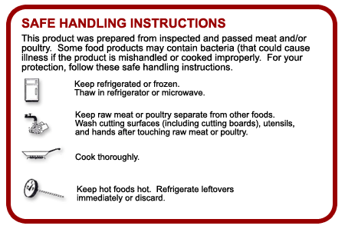
Consumer Education

Slide 5
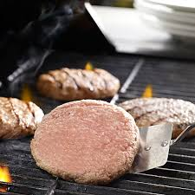
Consumer Education

Slide 6
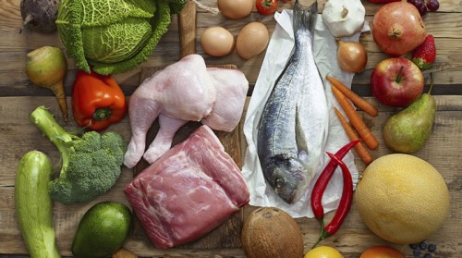
Cross Contamination

Slide 7
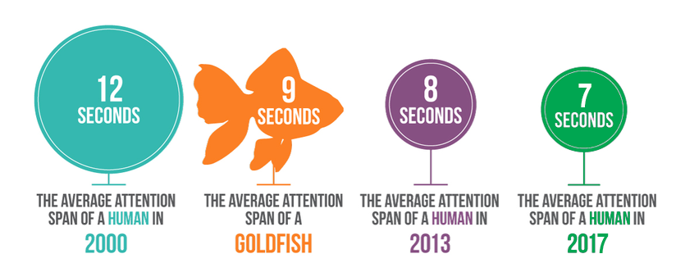
Reaching Consumers
We must be device-friendly, provide useful information, and capture
the audience’s interest quickly!

Slide 8
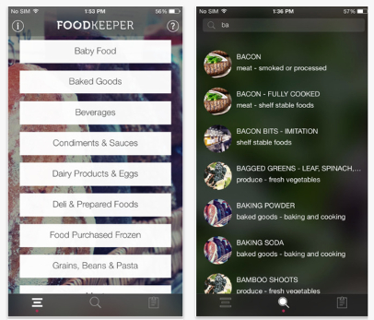
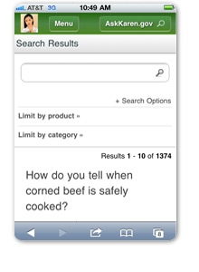
Food Safety Resources

Slide 9
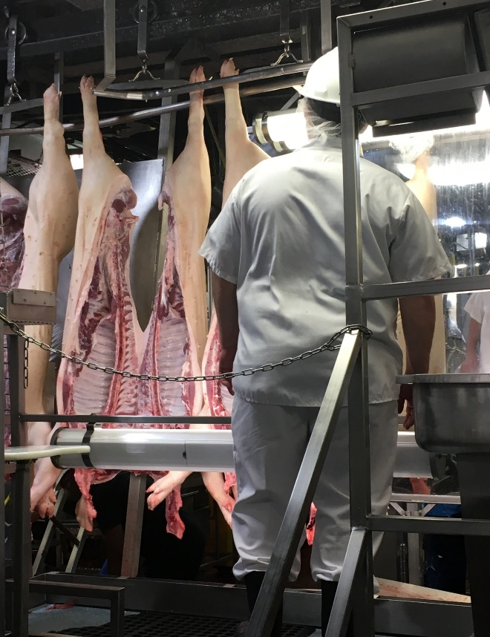
Science-Based Policy and Modernization

Slide 10
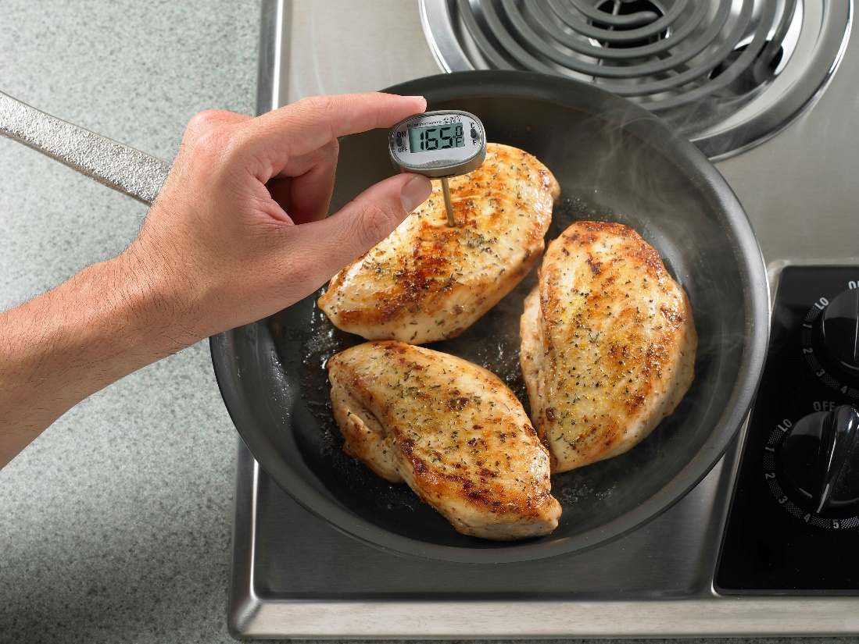
Salmonella Control

Slide 11
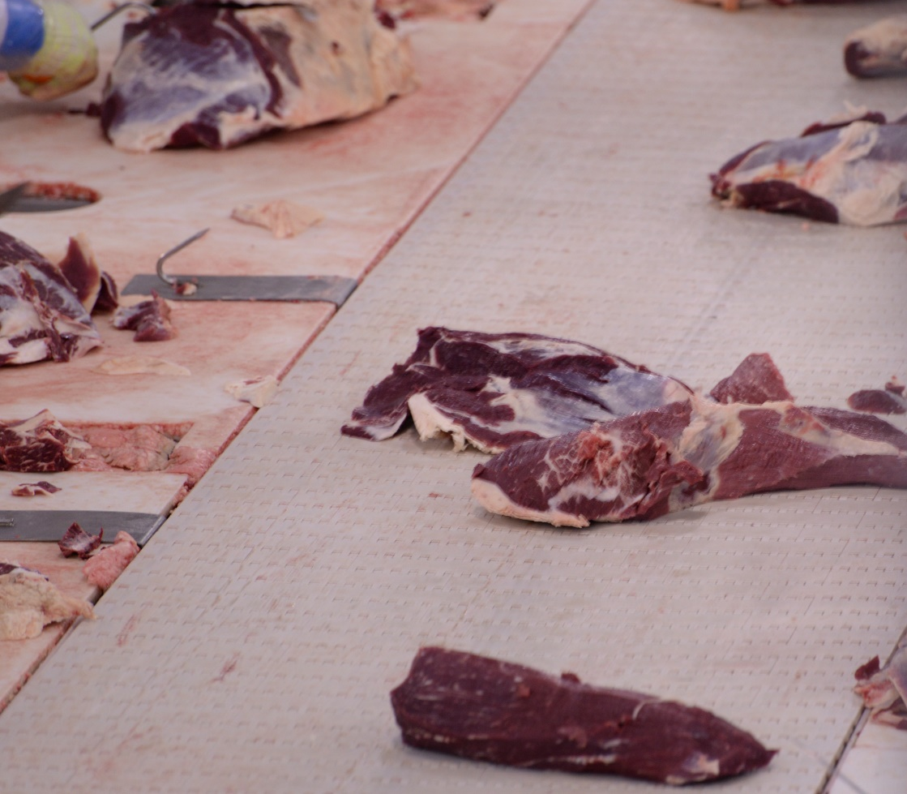
Expanding
non-O157
Sampling/Testing in Raw Beef Products

Slide 12
Recall Policy

Slide 13
Guidelines for Industry Response to
Customer Complaints

Slide 14
WWW.REGULATIONS.GOV
USDA/FSIS
1400 Independence Ave., S.W.
Mailstop 3758
Room 6065
Washington, D.C. 20250-3700

Slide 15
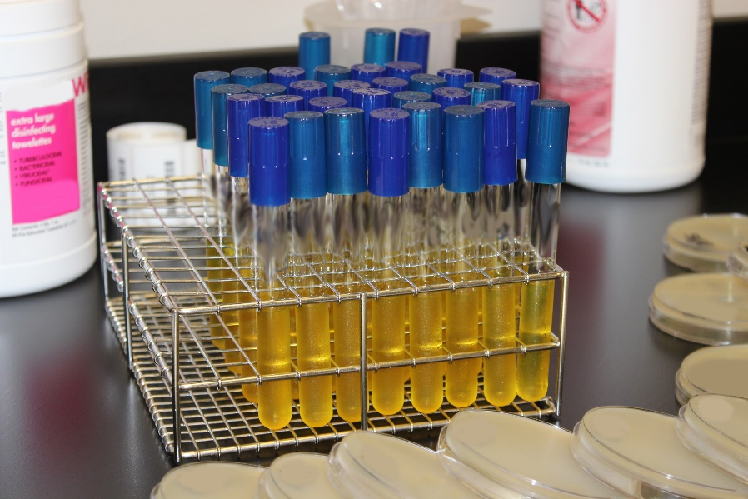
Antibiotic Resistance and Veterinary Drug Residue Testing

Slide 16
Do right and feed everyone…safely!

