Slide 1
Credit Matters
America’s Dual Financial Market & its Impact on Communities of Color
National Fair Housing Alliance
www.nationalfairhousing.org
@natfairhouse

Slide 2
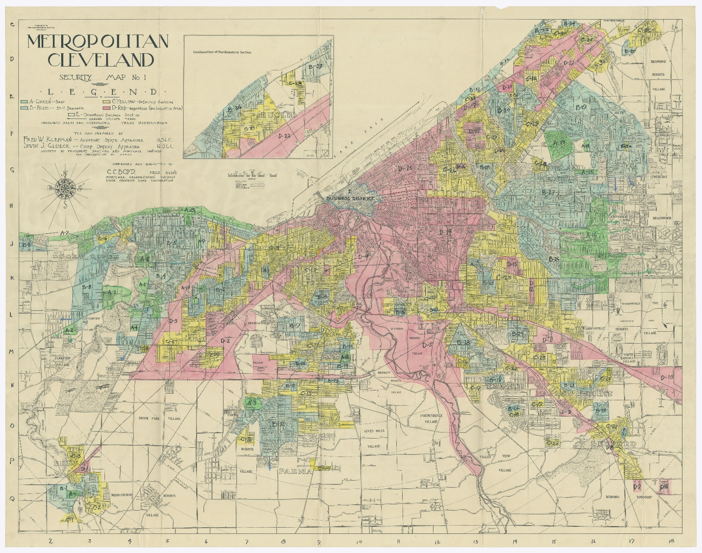
http://library.osu.edu/projects/redlining-maps-ohio/uncw-maps/195-HLCS-Metro_Cleveland_OH-Security_Map_No_1-1936-450-68-5-1-Box_87.jpg

Slide 3
Cleveland Residential Security Survey
“Proximity to industry is area’s best claim and it will retain present population for a few years at least, without marked increase of negro infiltration.”

Slide 4
Cleveland Residential Security Survey

Slide 5
http://library.osu.edu/projects/redlining-maps-ohio/uncw-maps/195-HLCS-Metro_Cleveland_OH-Security_Map_No_1-1936-450-68-5-1-Box_87.jpg

Slide 6
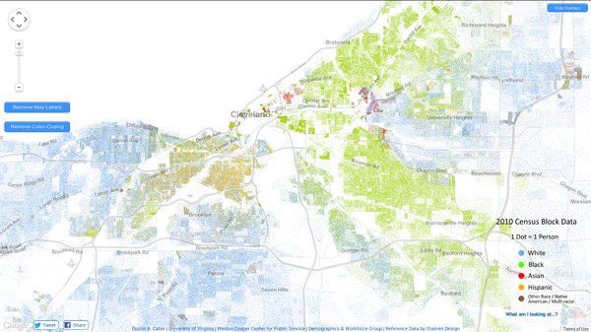
Redlined areas in the HOLC maps, which were based on 1939 racial demographics, track closely with today’s heavily segregated communities of color.

Slide 7
2005 – 2006 Subprime Loan Originations 2005 – Early 2008 Loan Foreclosures Cleveland

Slide 8
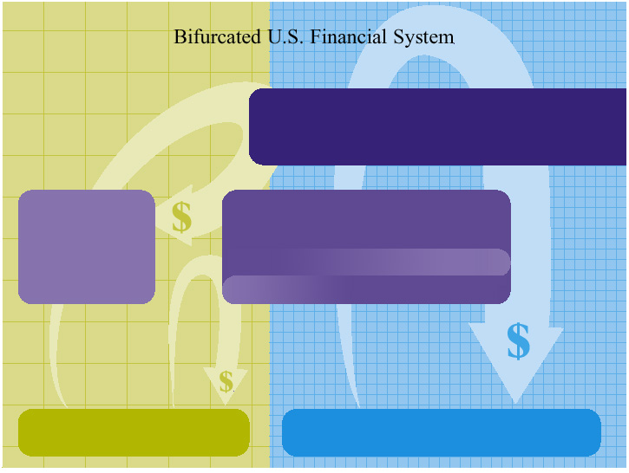
Bifurcated U.S. Financial System
Capital Markets
REITs, Mutual Funds, Pensions, 401(k)s, Stocks, Bonds, GSEs
AAA Rated Mortgage-Backed Securities
Alternative Financial Services
Pawnshops, Check Cashers,
Payday Lenders,
Rent-to-Own Shops,
Auto Title Lenders
Finance Lenders
Sub-Prime Lenders
Alternative Credit Sources
$
Mainstream Financial Services
Prime Mortgages, Savings and Checking Accounts, Home Equity Loans, Lines of Credit, CDs, Money Market Accounts
Prime Market
Jumbo Market
$
$
Predominately Communities of Color
Predominately Caucasian Communities
Jim Carr and National Fair Housing Alliance
Notes:
8
Widespread segregated residential patterns have actually made it easier to sustain a bifurcated financial system in the United States. Lenders can adopt marketing and branch location operations on a geographical basis and design those plans to exclude African-American and Latino communities. The U.S. Financial System, building on historical blatant and overt discrimination in the lending markets, has evolved into a highly complex, layered separate and unequal system of lending whereby high-cost, low-quality credit is readily available in lower-income, Black and Latino communities and low-cost, high quality credit is readily accessible in middle/upper-income, predominately White communities.

Slide 9
Data compiled from 2013 FDIC National Survey of Unbanked and Underbanked Households

Slide 10
AFS Usage Negatively Impacts Credit Scores
Subprime loans and non-traditional credit information is not reported to repositories when the payments are timely made.
Negative data is reported to the repositories.
People of color have higher uninsured rates and therefore may be more likely to have medical debt collections which can unfairly cause lower credit scores.
Scoring mechanisms do not control for predatory loan terms, distribution channels or debt collection procedures, which can negatively impact borrowers of color.
Borrowers may unduly have a lower credit score not because they themselves were risky but rather because the product they obtained, the distribution channel they used, their loan servicer or debt collection agency caused the risk.
Scoring models cannot pick up the fact that a consumer has credit available to use when the source of the credit is from a fringe lender.
Borrowers who face discrimination and therefore must pursue multiple lenders to seek credit will have a negative impact on their scores.
Notes:
African-Americans and Latinos earn less income than their White counterparts, they also experience much higher levels of unemployment. These issues will more than likely lead to African-americans and Latinos maintaining higher credit balances and thus having a higher ratio between their available credit and credit balance. This will result in a lower credit score.

Slide 11
SOLUTIONS
Broaden the scope of financial data fed into underwriting and credit scoring models.
State Housing Finance Agency data
CDFI data
Include the use of non-traditional credit, such as rental and insurance payments, in credit scoring and automated underwriting systems.
GSEs must broaden the scoring mechanisms accepted by their underwriting, compliance and securitization systems to include scores that consider non-traditional financial data.
Reduce the over-reliance on credit score and down-payment in underwriting and pricing processes.
GSEs must incorporate the acceptance of alternative credit in their automated underwriting systems and engage in appropriate risk pricing.
Prohibit reporting of negative data when there is no ability to report positive data from the creditor.
Timely paid modification or pay off plans should be reflected positively in credit repository data.
Consider how criteria such as distribution channel, appraisal quality, loan suitability, residual income, housing payment shock, etc. impact loan performance.
Remove shields from credit reporting and scoring system to make them more transparent.
Support educational initiatives that re-teach consumers how to manage and access credit.
Rating agencies should revamp their rating indices to include fair lending considerations.
Regulators must adequately assess the impact of credit scoring mechanisms on under-served groups.
Regulators and lenders must engage in efforts to better understand how credit scores really impact loan performance and how they impact borrowers of color.
Credit repositories must improve their processes for allowing consumers to correct erroneous information.
LLPAs must be adjusted to remove “tax” on consumers who utilize alternative financial services.
Lenders must remove credit overlays that penalize low-wealth borrowers and consumers who use alternative financial services.
Credit scoring systems must be greatly improved so that they more accurately assess the true risk posed by borrowers with a wide range of profiles and experiences.

