Slide 1

Watch Where You’re Going: Telematics, Auto Insurance, and the Need for Consumer Protections
By Michael DeLong
Research and Advocacy Associate, Consumer Federation of America

Slide 2
INTRODUCTION and overview
Auto insurers increasingly use telematics programs to get consumer-generated driving data and use data for insurance pricing
Programs show substantial promise for consumers but also pose major risks
Strong, effective oversight and regulations are needed to ensure these programs benefit consumers and are not misused

Slide 3
AUTO INSURANCE IMPACTS NEARLY EVERY CONSUMER
Drivers are required to purchase auto insurance
Regulators must ensure this product is affordable and that consumers are not subject to unfair discrimination
Robust government oversight needed to make sure this market functions well
With new products, including tech-driven products, guardrails and rules should be developed early so problematic practices aren’t baked into the system

Slide 4
The RISE of Telematics/Usage based insurance
Insurance programs that capture data from consumers’ cars and mobile phones while driving, and use that data to calculate insurance premiums
GPS was adapted for civilian use and paved the way for telematics
Progressive started Snapshot back in 1998 and now all the largest auto insurers have their own programs

Slide 5
Goal is to evaluate Consumer driving behavior and price accordingly
Data allow insurance companies to directly evaluate certain driving behavior and calculate rates based on that behavior, with pricing meant to closely reflect risk
Insurers state that another goal of programs is to encourage safer driving
But insurers have generally withheld the full scope of these programs and there is little transparency

Slide 6
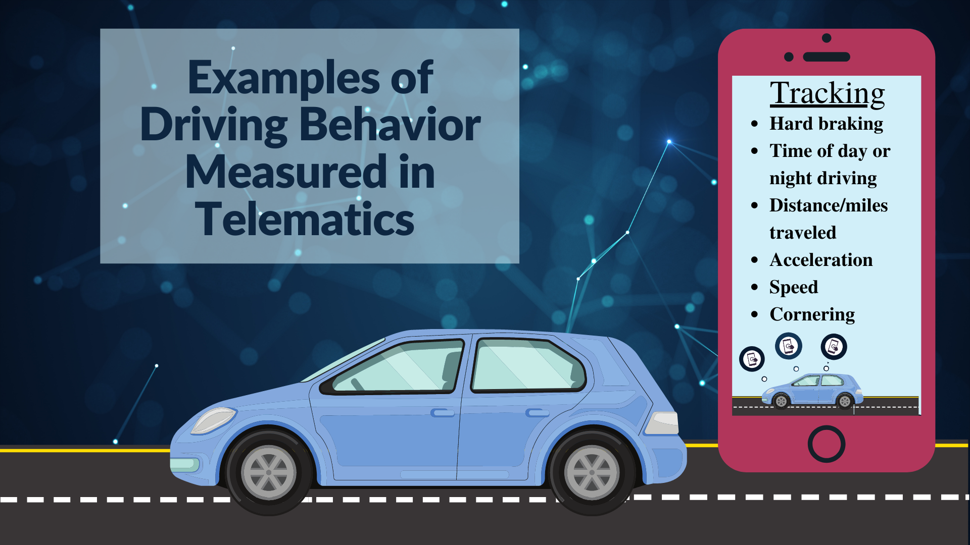

Slide 7
POSSIBLE BENEFITS for consumers…
Telematics could replace currently used socioeconomic factors (credit history, education levels, job, homeownership status, ZIP code, etc.) with better pricing systems
Premiums could be more closely aligned with risk, theoretically reducing costs for safe drivers
Better calculations of risk and likelihood of crashes and claims

Slide 8
BUT ALSO Serious PROBLEMS For consumers
Data privacy issues for consumers, including what information is being gathered and what it is used for
Little or no transparency regarding algorithms and data models, including unintended bias and unfair discrimination
Continued use of non-driving factors—any rating system that relies on telematics should eliminate them
Insurer abuse of programs to raise costs

Slide 9
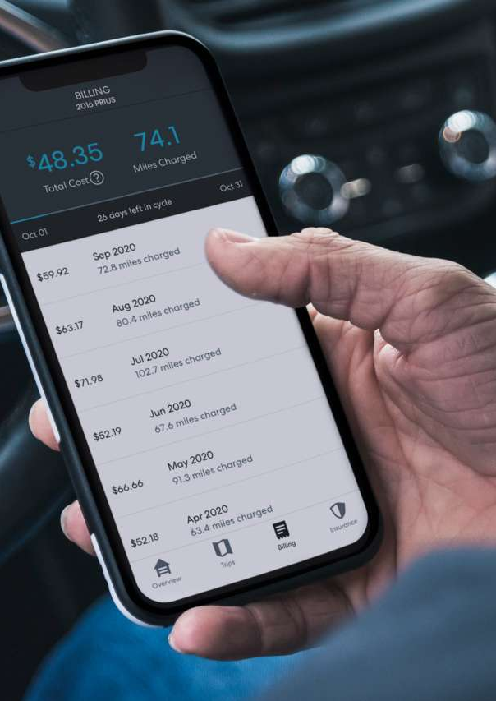
WHAT DATA Is COLLECTED, and What is it used for?
Insurers acknowledge some data that telematics systems collect, like miles driven, speed, hard braking
But very likely other data points remain hidden
CFA and Consumer Reports both investigated the data collected

Slide 10
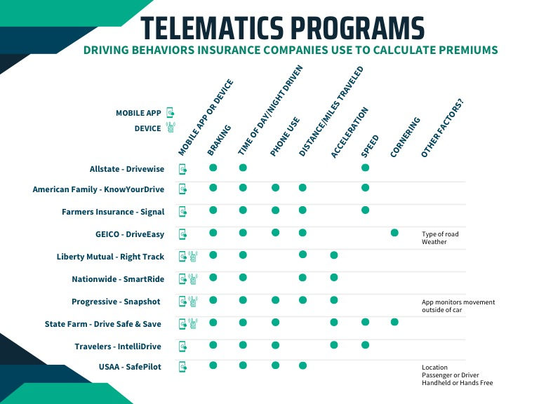
Notes:
Source: Consumer Reports

Slide 11
Skepticism from consumers about telematics
Many consumers are wary of telematics programs and have been slow to sign up
Insurers are promoting telematics and trying to make it the default option, but telematics may be vulnerable to hackers and other malicious actors
Oldest programs have been around for over twenty years but have been adopted by only a minority of drivers

Slide 12
68% of Americans will not install telematics devices
Recent Policy Genius study found that 68% of Americans would not install app that collects driving behavior or location data for insurance discounts
32% of Americans would use telematics if offered a discount
Of those 32%, 67% would only use programs if it lowered their rates by half or more
Getting telematics governance right is better than getting it fast

Slide 13
Our recommendations: DATA COLLECTION MUST BE TRANSPARENT AND PROGRAMS VOLUNTARY
Consumers and regulators need to know all the data points collected by insurers and third-party vendors
Mileage and a few other datapoints cited publicly by insurers, but possible that other behaviors are being collected
Telematics must be completely voluntary for consumers—no pressure or requirements

Slide 14
Standards for data collected and used
Strict limits on data collected and used by insurers in telematics programs
Regulators should only allow, after review, data demonstrably related to the risk of loss
Insurers must provide actuarial justification and causative explanation for each data point used—each component must be related to risk
Third-party vendors should be subject to state insurance department oversight

Slide 15
Transparency of algorithms
Regulators, elected officials, and consumers need to see how algorithms work—what goes into the calculations and what comes out
All components and inputs should be identified and so should the weight given to them
Algorithms should be presented to consumers in plain language, with weighted percentages of each driving behavior

Slide 16
STRONG PRIVACY STANDARDS
Consumers should have control over their driving behavior data and determine what it is used for
Data should only be used for evaluating risk
Data should not be sold or shared with other corporations or affiliates for marketing or other purposes
Consumers should receive regular accounting of the data collected and how it has been been used to rate their policies

Slide 17
Testing for disparate impact
Disparate impact analysis of telematics algorithms to find and correct unfair discrimination against protected classes
Biased data can perpetuate and reinforce structural racism
Colorado law SB 21-169 is a good first step—establishes stakeholder process for getting rid of unfair discrimination

Slide 18
What actions the naic should take
NAIC should adopt a model bill governing telematics
Bill should require insurers to provide explanations of how factors are connected to risk
Also require public disclosure of scoring methodologies
Require testing to ensure telematics doesn’t result in unfair discrimination

Slide 19

Questions? Contact us at
mdelong@consumerfed.org

