Slide 1
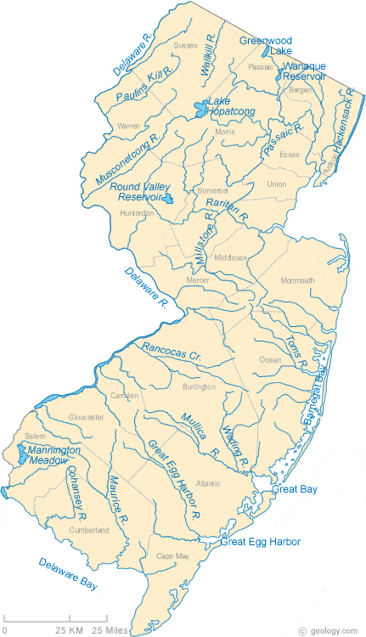
Insurance Premiums in New Jersey Vary Dramatically by ZIP Code Demographics
 | Average Premium by Credit History
ZIP Code Demographics | Excellent Credit | Fair Credit | Poor Credit | Average Premium
Majority Black | $1,125 | $1,912 | $3,038 | $2,025
Majority Latino | $1,127 | $1,918 | $3,047 | $2,031
Majority White | $790 | $1,287 | $1,988 | $1,355
Below $50K Median Income | $1,093 | $1,851 | $2,934 | $1,959
Above $150K Median Income | $760 | $1,230 | $1,890 | $1,293
Total Statewide | $842 | $1,384 | $2,153 | $1,460
Majority Black ZIP Codes: +49.5% higher premiums than majority white ZIPs
Majority Latino ZIP Codes: +49.9% higher premiums than majority white ZIPs
Low-income ZIP Codes: +51.5% higher premiums than high-income ZIPs
Source: Quadrant Information Services, LLC. The data are representative of publicly sourced data for a 35-year old driver with a clean driving record and other standardized characteristics. Individual customer rates may differ to the extent their personal characteristics differ from the base profile used.

