Slide 1
Is Mortgage Credit Too Tight? What the Data Tells Us
Alanna McCargo
Co-Director, Housing Finance Policy Center
Urban Institute
CFA Financial Services Conference
December 1, 2016
Washington, DC

Slide 2
The Tight Credit Culprits
Credit remains tight, but some progress has been made. The following are major culprits to tight credit in today’s mortgage lending environment:
Credit models: more higher-credit borrowers, fewer lower-credit borrowers
Underwriting standards, time and cost
Regulation, Litigation (False Claims) and repurchase fears
Lender restrictions and overlays
High cost of servicing (even in a lower default servicing environment)
Continued uncertainty and lack of private participation
Mortgage product mix
“It’s time to lend again to borrowers with less-than-perfect credit.”
–Dr. Laurie Goodman, Urban Institute
2

Slide 3
Access to Credit Remains Tight: Urban’s Housing Credit Availability Index (HCAI)
Default Risk Taken by the Mortgage Market, 1998Q1–2016Q2
2016 Q2
Sources: eMBS, Federal Housing Administration (FHA) and the Urban Institute.
Note: All series measure the first-time homebuyer share of purchase loans for principal residences.
3

Slide 4
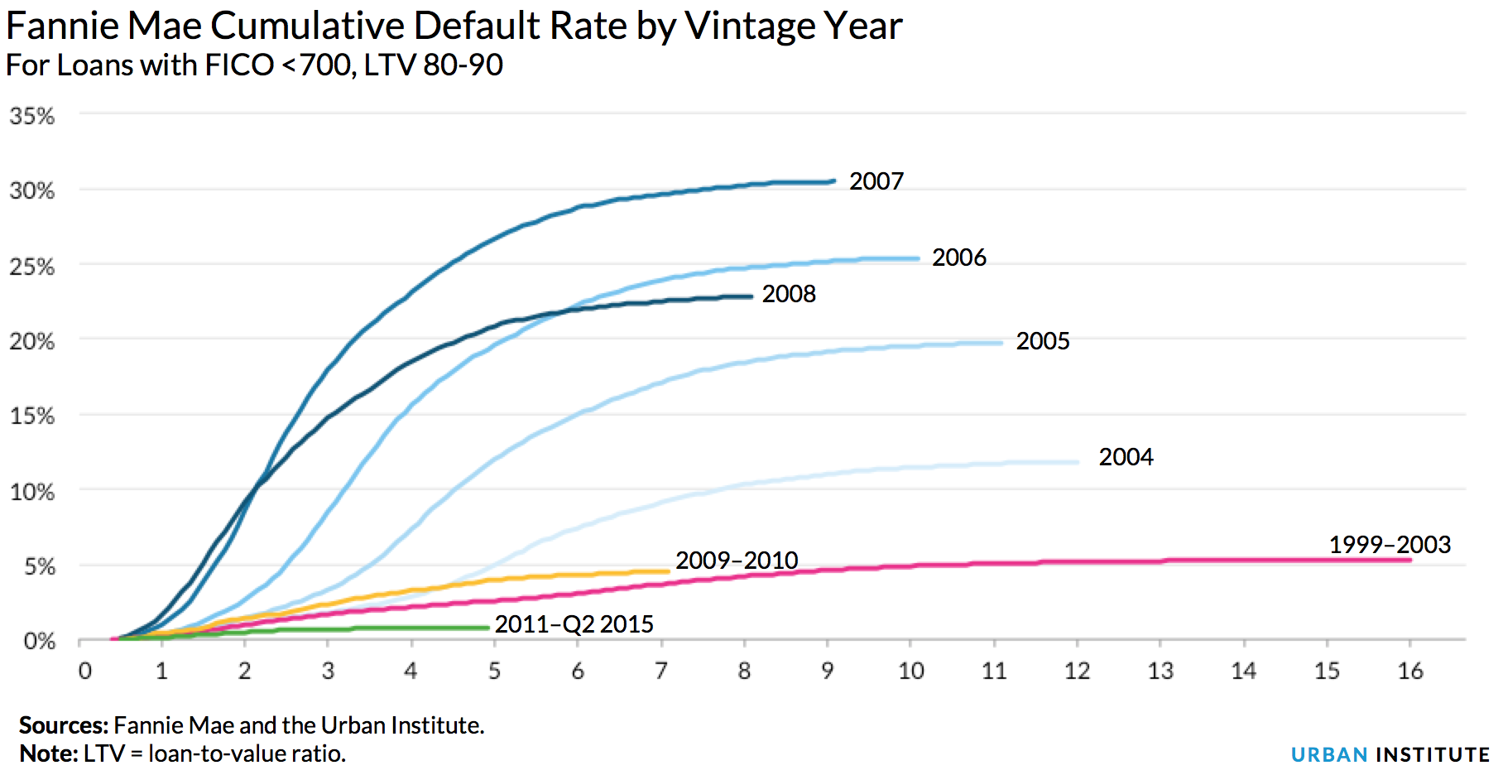
Today’s mortgage borrowers are not defaulting - their perfection is ‘off the charts’
Sources: Fannie Mae Single Family Loan-Level Dataset and Urban Institute calculations
4

Slide 5
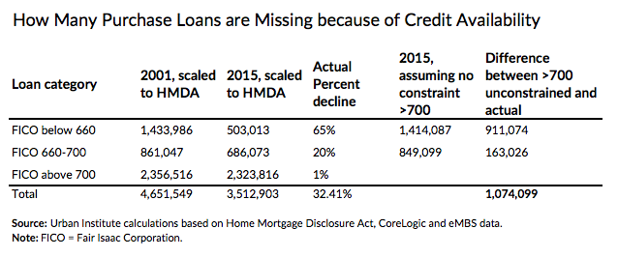
1.1 million missing loans in 2015
Cumulative missing loans, 2009-2015: 6.3 million
5

Slide 6
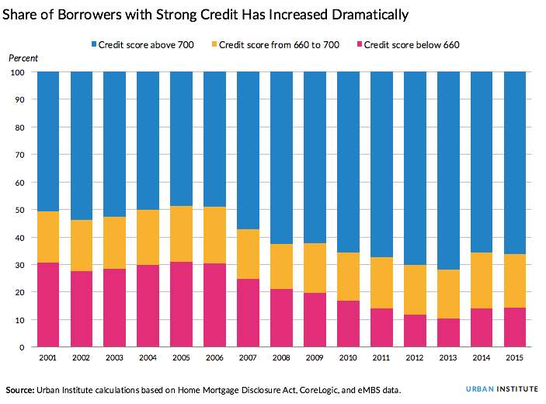
More high-credit borrowers, fewer low-credit borrowers
6

Slide 7
First-Time Homebuyer Characteristics
 | GSEs |  | FHA |  | GSEs and FHA
Characteristics | First-time | Repeat | First-time | Repeat | First-time | Repeat
Loan Amount ($) | 226,091 | 249,867 | 195,264 | 217,553 | 211,367 | 243,524
Credit Score | 741.4 | 755.3 | 680.07 | 687.88 | 712.13 | 742.07
LTV (%) | 86.43 | 79.52 | 95.6 | 94.41 | 90.42 | 82.04
DTI (%) | 33.51 | 34.22 | 40.92 | 41.77 | 37.05 | 35.7
Loan Rate (%) | 3.69 | 3.59 | 3.69 | 3.61 | 3.69 | 3.59
Sources: eMBS and Urban Institute. Note: Based on owner-occupied purchase mortgages originated in August 2016.
7

Slide 8
Borrower Race, Ethnicity, and Income: Origination
HMDA data shows stagnant or worse performance for loans in lower to medium income tiers and less lending overall in the past 10 years to minority groups.
 | 2004 | 2006 | 2009 | 2012 | 2013 | 2014 | 2015
Borrower race/ethnicity
Black | 6% | 9% | 4% | 4% | 4% | 5% | 5%
Hispanic | 10% | 13% | 6% | 6% | 7% | 8% | 9%
Non-Hispanic White | 58% | 61% | 74% | 73% | 71% | 69% | 68%
Asian | 5% | 4% | 5% | 6% | 6% | 6% | 6%
Borrower income
Low | 12% | 10% | 9% | 10% | 10% | 11% | 10%
Moderate Low | 18% | 17% | 16% | 14% | 15% | 16% | 15%
Medium | 21% | 21% | 20% | 18% | 18% | 19% | 19%
Moderate High | 24% | 25% | 26% | 25% | 25% | 24% | 25%
High | 25% | 28% | 29% | 33% | 33% | 31% | 31%
Total Originations
 | 15,028,550 | 13,970,183 | 8,950,936 | 9,783,966 | 8,706,657 | 6,039,826 | 7,404,258
Sources: HMDA; Urban Institute Calculations
8

Slide 9
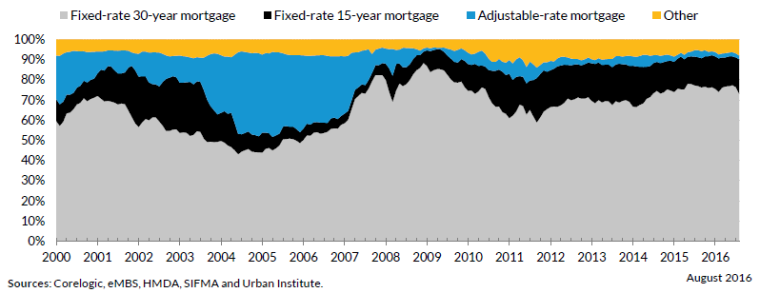
Originations by Channel & Product Type
Channel Mix
Product Mix
9

