Slide 1
Making Solar Energy Affordable for all Americans:
The U.S. Department of Energy SunShot Initiative
Minh Le, Director,
U.S. Department of Energy
Solar Energy Technologies Office

Slide 2
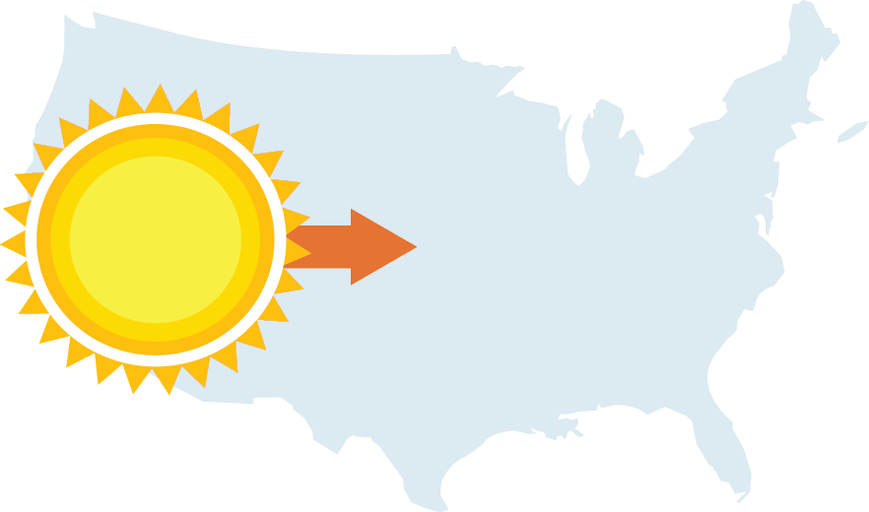
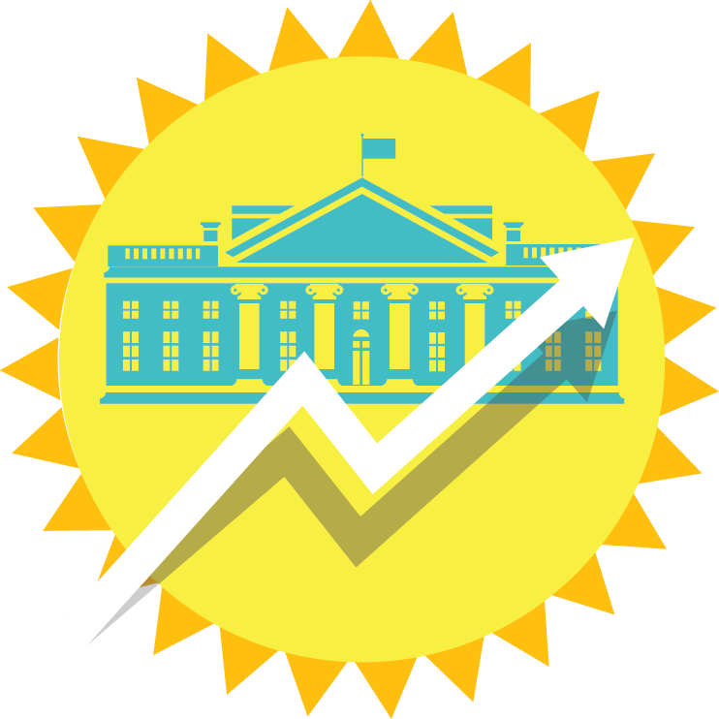
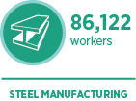
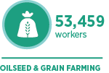
State of Solar Energy in the U.S.
Increasing capacity, lowering costs
64%
By end of 2014…
Enough to power
20
GW
4,000,000
average American homes
From 2008-2016,
22x more solar
Creating jobs, economic growth
Nearly
174,000 workers
22% in 2014
Notes:
State of Solar Energy in the U.S.
Increasing capacity, lowering costs
In 2014, solar deployment is slated to be up nearly 40% over 2013 with an estimated 20GW of installed capacity, enough to power the equivalent of 4 million homes. The U.S. has become the third largest solar market in the world.
The U.S. solar market is expected to continue its growth trajectory. By the end of this Administration, the amount of solar power installed in the U.S. will have increased to 40GW—a factor 22 increase since 2008.
Since the beginning of 2010, the average cost of solar PV panels has dropped more than 64% and the cost of a solar electric system has dropped by about 50%
Americans Choosing Solar
Solar installations are overwhelmingly occurring in middle class neighborhoods with incomes ranging from $40K-$90K.
For 46 of America’s 50 largest cities, a fully-financed, typically-sized solar PV system is a better investment than the stock market, and in 42 of these cities, the same system already costs less than energy from a residential customer’s local utility.
Creating Jobs, Economic Growth
Solar is having a similar economic impact compared to other cornerstone American industries. The U.S. steel industry employs 86,122 workers, automobile and light truck manufacturing industry employs 142,177, the oilseed and grain farming industry employs 53,459.
As deployment has soared, so have solar jobs. Today, the U.S. solar industry employs nearly 174,000 workers in high-paying jobs, up 22% over 2013. The solar industry is expected to grow by 24% annually.

Slide 3
Why SunShot
Price
SunShot Goal: 5 - 6¢/kWh without subsidy.
A 75% cost reduction by 2020.
SunShot
Initiative
Notes:
The SunShot Initiative is a collaborative national effort to reduce the total cost of solar by 75% so it can be cost-competitive with other energy sources by 2020. DOE supports several programs that work toward this aggressive goal along the entire cost spectrum. Among these, the Incubator program is unique because it addresses all of the targeted reduction areas needed to achieve cost parity.

Slide 4
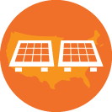
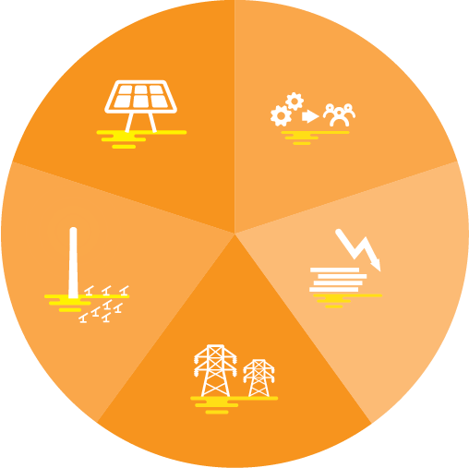
Progress Towards SunShot Goal
Maintaining U.S. Leadership
in PV R&D Innovation
Empowering Communities to Cut
Red Tape, Streamline Processes
Building a Skilled
Solar Workforce
Supporting Entrepreneurs
and Innovators
Training Veterans for the
Clean Energy Economy
Supporting
Domestic Manufacturing
6¢/kWh
70% to the SunShot goal
Notes:
SunShot
Who we are: Launched in 2011, SunShot aggressively drives innovation to make solar energy fully cost-competitive without incentives with traditional energy sources before the end of the decade.
What we do: SunShot funds efforts by private companies, universities, and national laboratories across Photovoltaics (PV), Concentrating Solar Power (CSP), Soft Costs (or Balance of Systems Cost), Systems Integration, and Technology to Market to drive down the cost of solar electricity to $0.06 per kilowatt-hour. We work to make it faster, easier, and cheaper for Americans to choose solar energy in their daily lives.
Less than five years into the Energy Department’s decade-long SunShot Initiative, the solar industry is already more than 70% of the way to achieving SunShot’s cost target.
SunShot Success
Maintaining U.S. Leadership in PV R&D Innovation
More than 50% of the solar cell efficiency world records were supported by DOE and SunShot.
Empowering Communities to Cut Red Tape, Streamline Processes
SunShot works with local governments to reduce solar soft costs, like permitting timelines and cutting red tape to create strong solar markets and make it faster, cheaper, and easier for Americans to go solar.
Building a Skilled Solar Workforce
Through its successful Solar Instructor Training Network, SunShot is supporting professional development of trainers and instructors of solar PV and solar heating and cooling technologies in 49 states across nearly 400 community colleges. Since 2010, SITN has trained >30,000 students to enter the solar workforce, on the way to the goal of 50,000 by 2020.
Supporting Entrepreneurs and Innovators Pays
For every $1 in government investment into small solar businesses through SunShot’s Incubator program, those companies have turned around and earned more than $18 in private follow-on funding. SunShot’s investments are paying dividends for our domestic clean energy economy.
Training Veterans for the Clean Energy Economy
Veterans make up roughly 10% of the solar workforce – 17,000 workers – compared to less than 5% nationally for any other industry sector. To expand solar training access to interested veterans, SunShot launched a pilot solar installation training program for transitioning tech-savvy military personnel at three military bases: Camp Pendleton (Marines, San Diego, CA), Fort Carson (Army, Colorado Springs, CO), and Naval Station Norfolk (Navy, Norfolk, VA) starting January, continuing through fall, 2015. First class to graduate Feb 13.
Supporting Domestic Manufacturing
SunShot is supporting innovation in manufacturing to ensure U.S.-developed technologies can capture a larger portion of the global value in solar manufacturing, currently estimated to be about $120 billion worldwide.

Slide 5
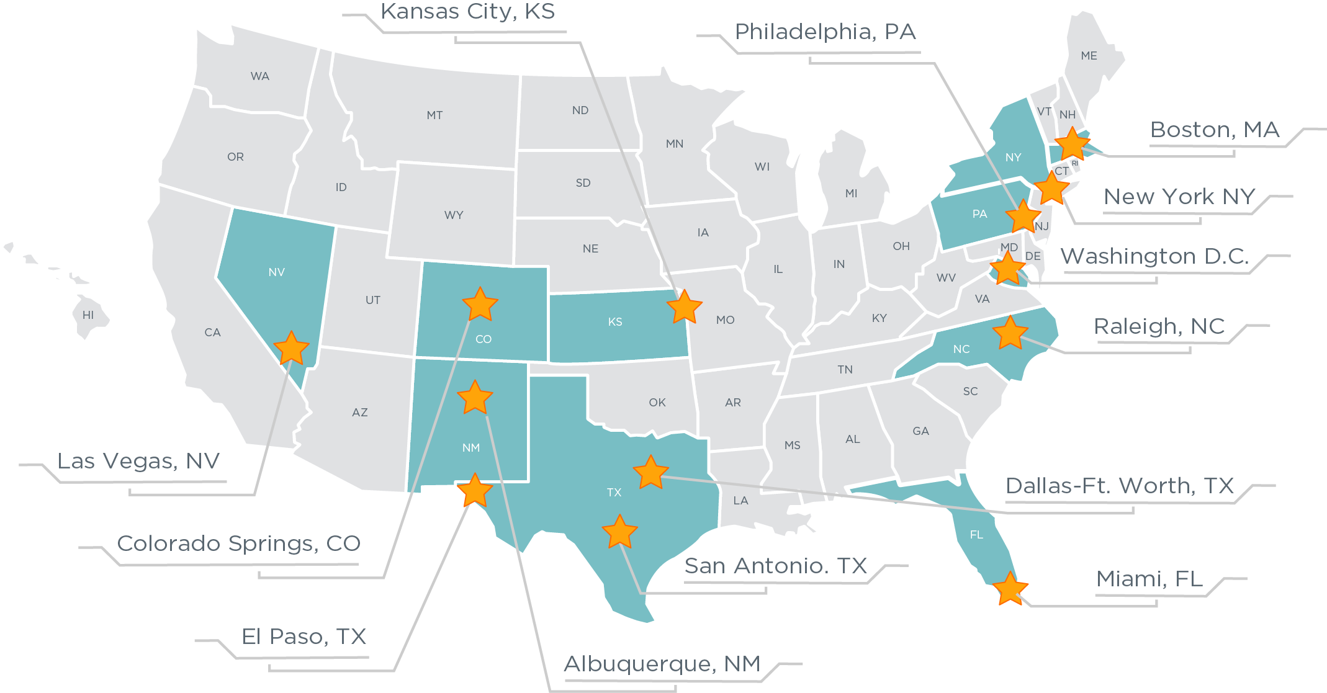
Americans Choosing Solar Energy
Most Affordable Solar Cities for Homeowners
Incomes $40K-$90K
Middle Class Americans are Solar Customers

Slide 6
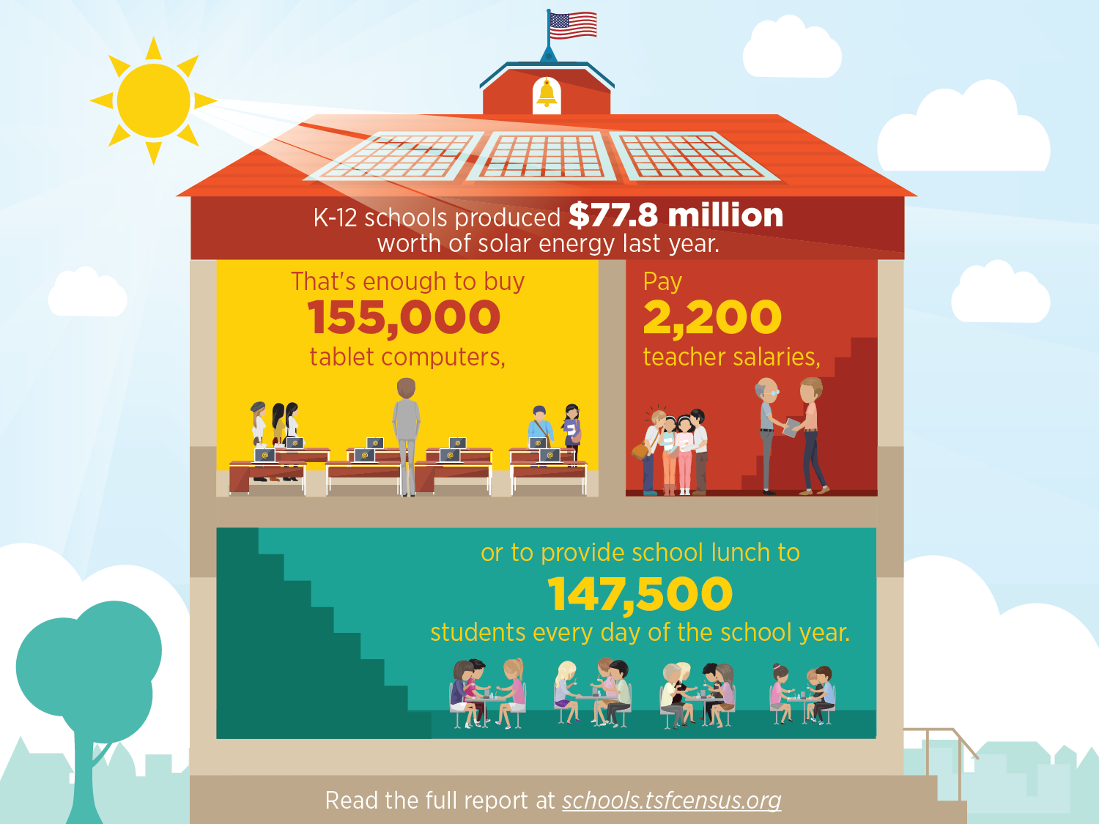
Solar Powers U.S. Schools

Slide 7
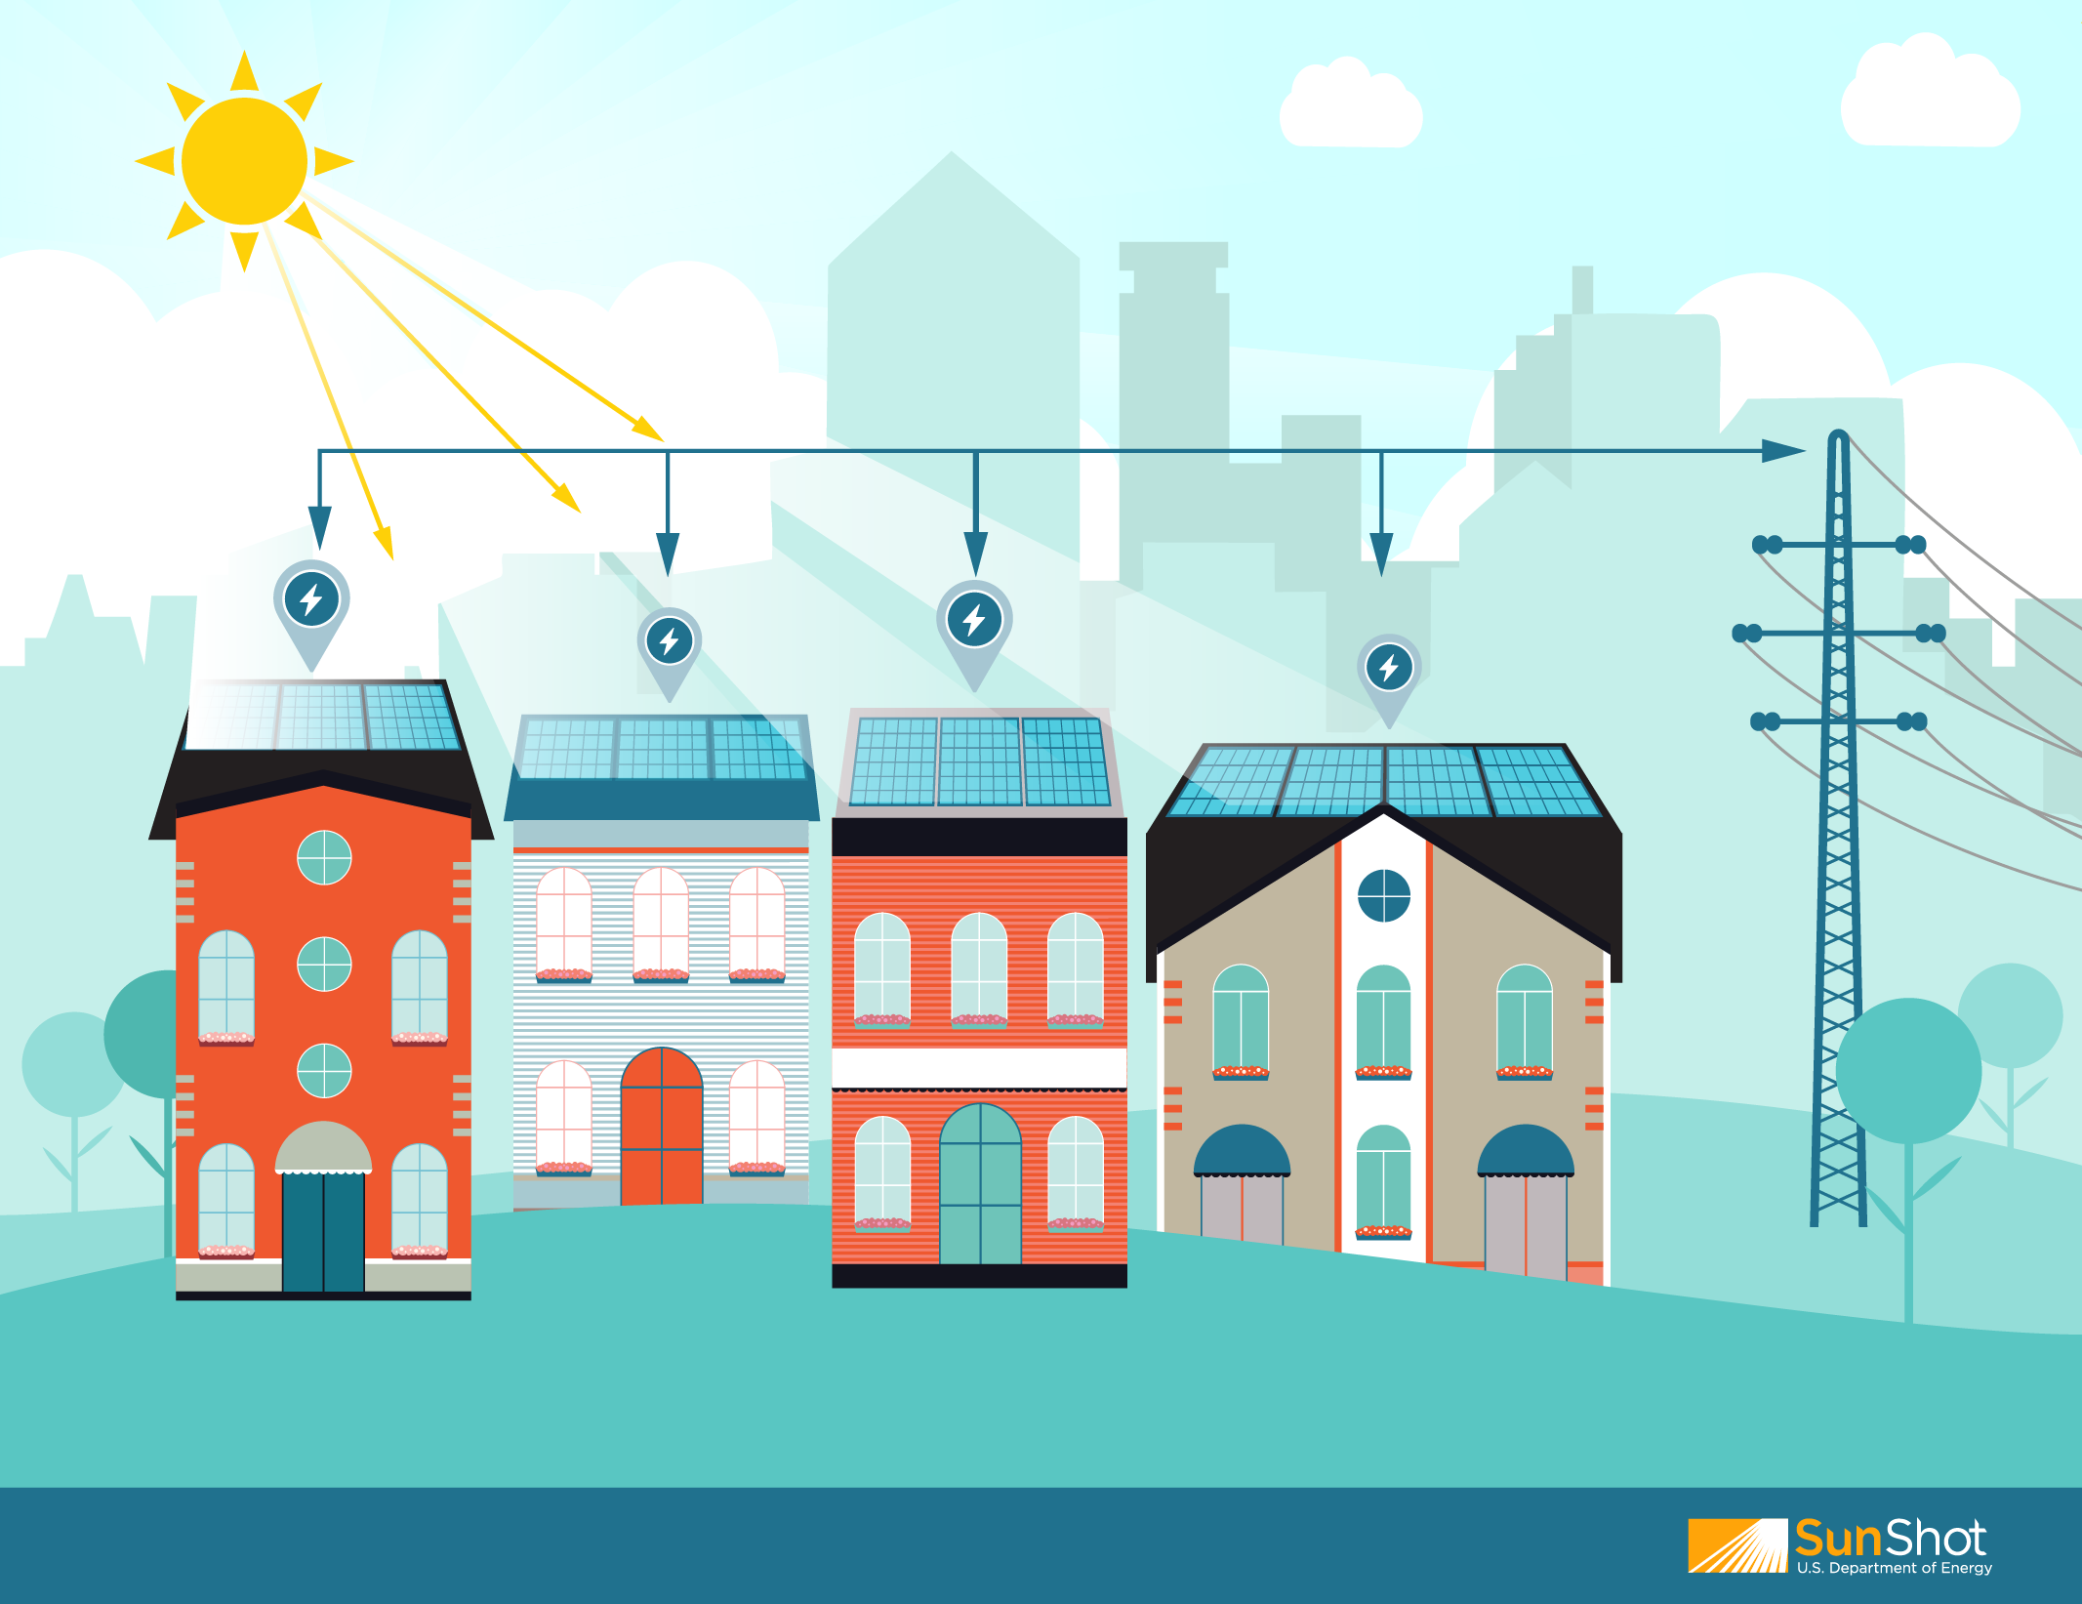
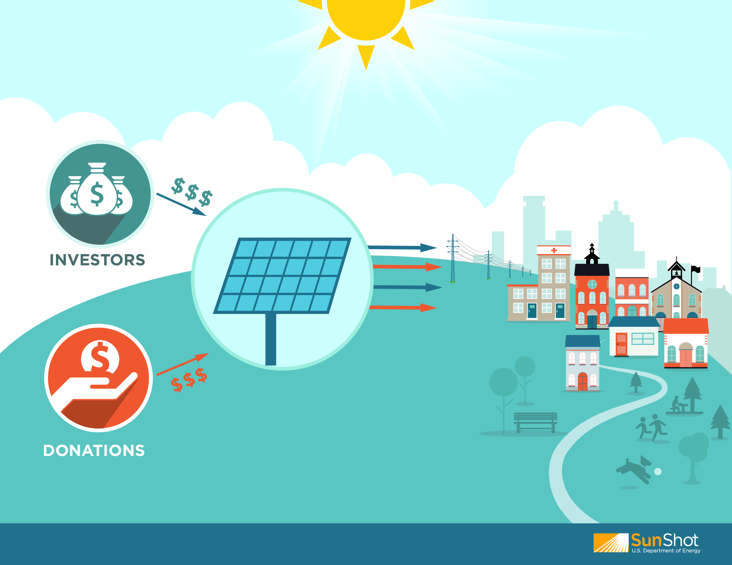
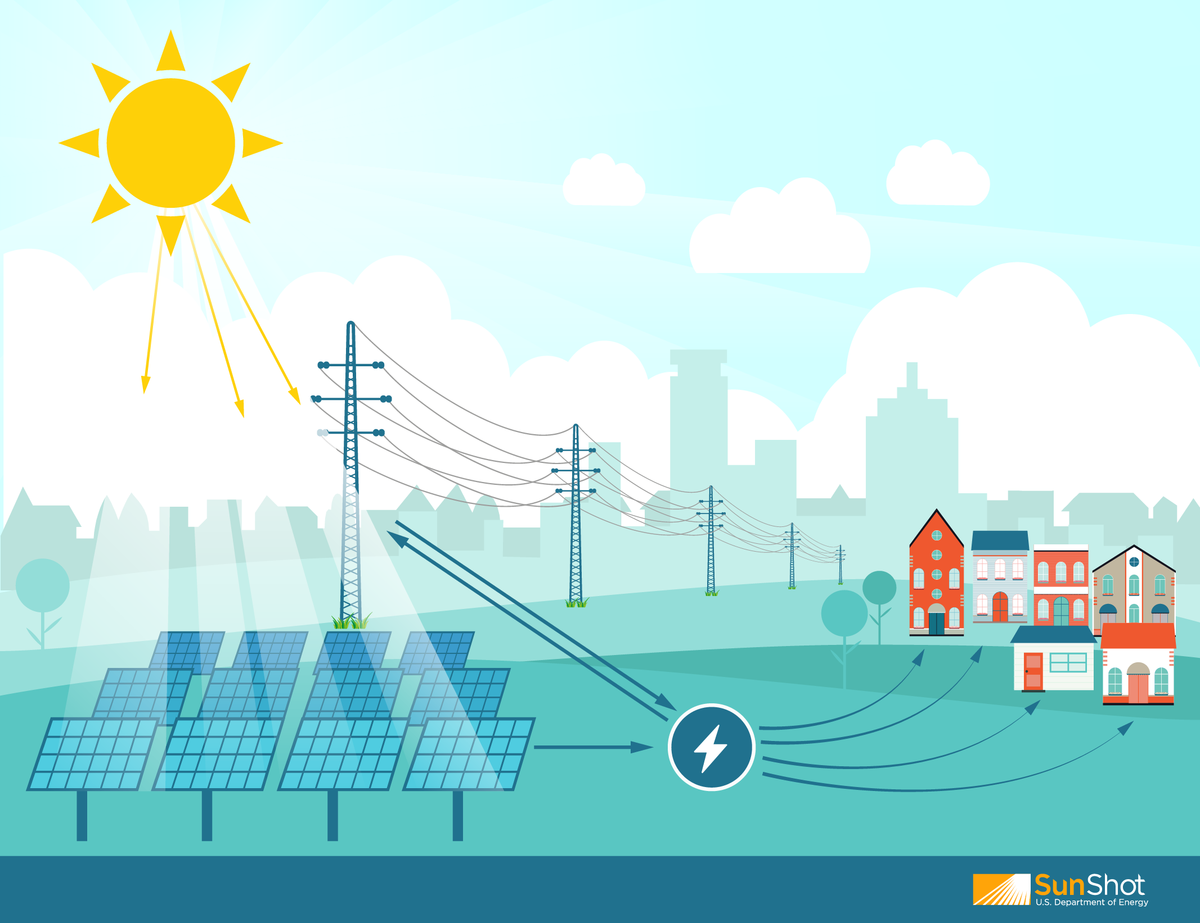
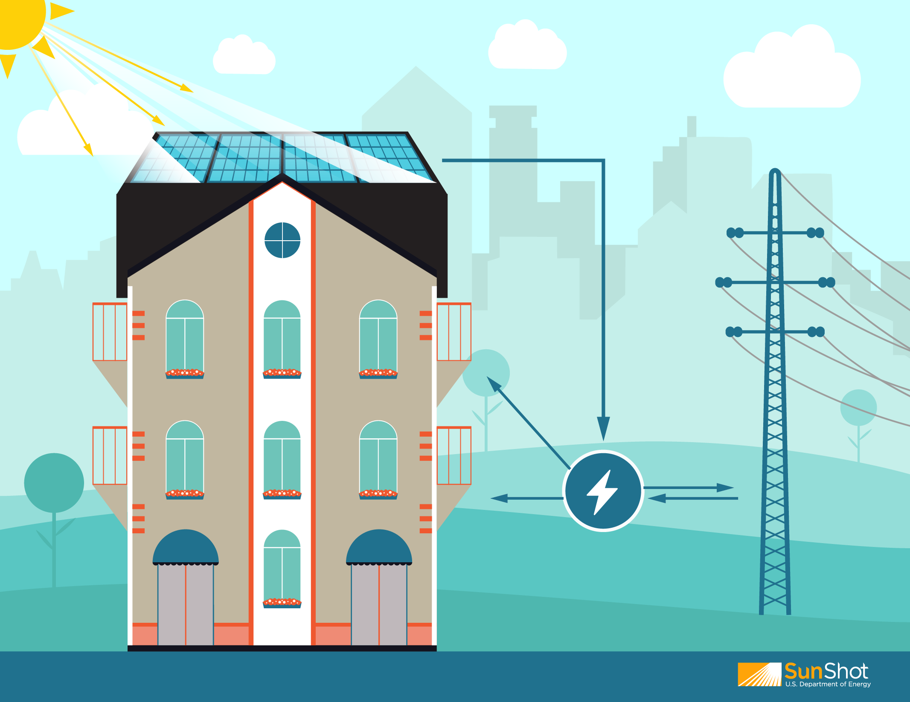
Opportunities Beyond the Residential Rooftop
Community Solar
Community members work together to enable solar in their community
Group Purchasing
Financial (Invest or Donate)
Shared
Solar
Participants own or lease panels, buy kWh blocks of generation, or own an interest in a shared system
Offsite
Onsite (Multi-Unit Buildings)
6
Notes:
Group purchase: Community members join together to get lower prices on individual solar arrays
Investor: Community investors enable lower-cost financing of projects
Donation: Community members donate to put a solar array on a school, church, or municipal building
Offsite shared solar: utility-sponsored, developer/utility partnership, nonprofit/neighborhood, 3rd party/LLC
Onsite shared solar: multi unit building

Slide 8
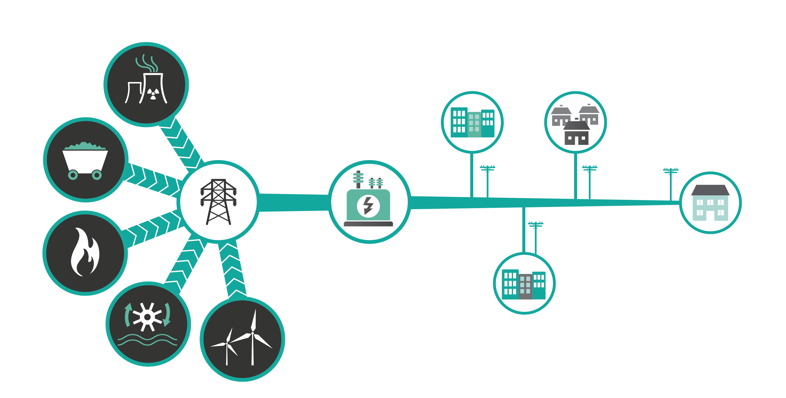
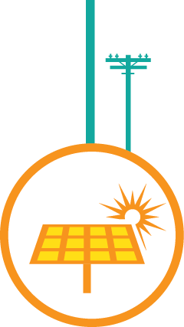
Today’s Power System: Two-Way Power Flow

