Slide 1
America’s Current Politics: The Consumer’s Perspective
Scott Keeter
Director of Survey Research
Consumer Federation of America
Consumer Assembly 2013
Washington, DC
March 14, 2013

Slide 2
Overview of the Mood of the Country

Slide 3
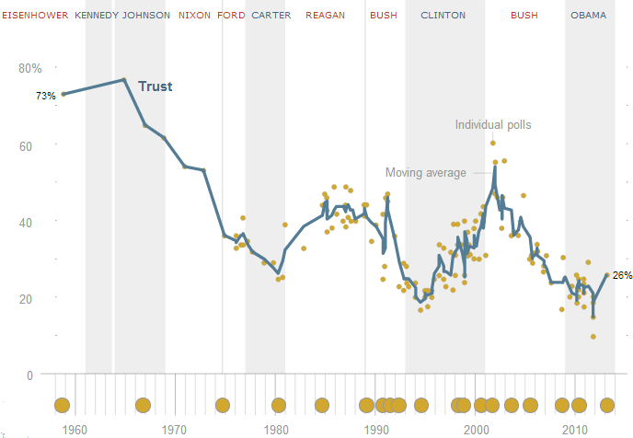
Trust in Government, 1958-2013

Slide 4
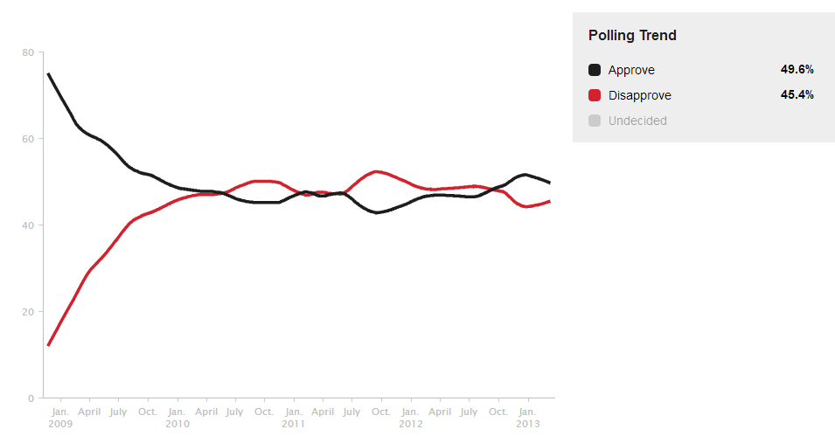
Presidential Approval, 2009-2013

Slide 5
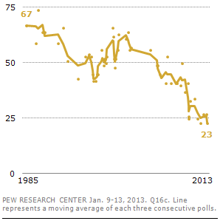
Congress’s Sinking Favorability

Slide 6
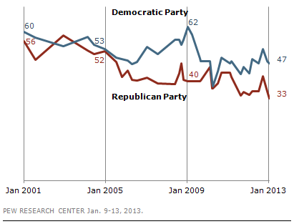
Favorable Ratings of the Parties

Slide 7
Driving the Discontent: The Economy, But Also Gridlock and Polarization

Slide 8
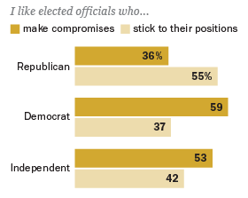
Partisan Gaps on Political Compromise

Slide 9
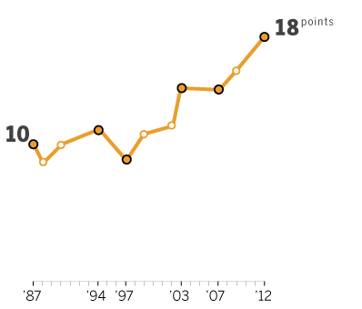
Political Values and Partisanship
April 2012 American political values survey

Slide 10
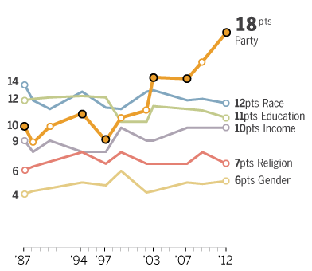
Growing Party Divides, But Not Other Divides
April 2012 American political values survey

Slide 11
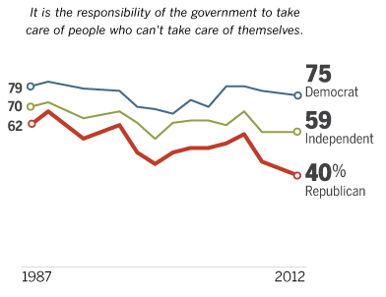
Growing Partisan Divisions—Social Safety Net
April 2012 American political values survey

Slide 12
Growing Partisan Divisions—Environment
There need to be stricter laws and regulations to protect the environment
April 2012 American political values survey

Slide 13
Growing Partisan Divisions—Labor
Labor unions are necessary to protect the working person
April 2012 American political values survey

Slide 14
Growing Partisan Divisions—Immigration
The growing # of newcomers from other countries threaten traditional
American customs and values
April 2012 American political values survey

Slide 15
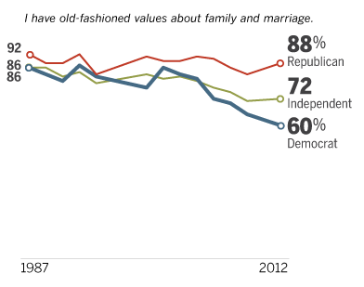
Growing Partisan Divisions—Social Values
April 2012 American political values survey

Slide 16
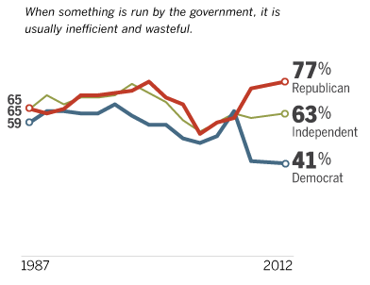
Views of Government, More Divided, Cyclical
April 2012 American political values survey

Slide 17
The Deficit and Government Spending

Slide 18
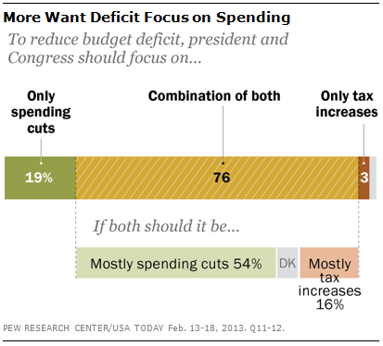
Tax and Cut Spending, But More Cuts Than Taxes

Slide 19
Public Rejects Spending Cuts in Most Areas

Slide 20
Public Rejects Spending Cuts in Most Areas

Slide 21
Public Rejects Spending Cuts in Most Areas

Slide 22
Public Rejects Spending Cuts in Most Areas

Slide 23
A More Austere Public Than in the Past

Slide 24
A More Austere Public Than in the Past

Slide 25
A More Austere Public Than in the Past

Slide 26
America’s Current Politics: The Consumer’s Perspective
Scott Keeter
Director of Survey Research
Consumer Federation of America
Consumer Assembly 2013
Washington, DC
March 14, 2013

